Slide 1
An average-case lower bound against ACC⁰
Igor C. Oliveira
University of Oxford
Joint work with Ruiwen Chen and Rahul Santhanam

Slide 2
Context and Background

Slide 3
Establish unconditional lower bounds on the complexity of computations.
Hartmanis-Stearns (1965): If a < b, Turing Machines running in time O(n^{b}) can solve more problems than TMs running in time O(nª).
Baker-Gill-Solovay (1975): High-level techniques such as simulation and diagonalization alone cannot separate classes such as P and NP, etc.
It seems that we need to understand low-level details of computation to make progress…

Slide 4







Circuit Complexity
V
V
V
V
V
V
V
V
V
V
V
V
V
V
V
▶ Defined by a DAG, internal nodes labelled by AND / OR.
▶ A Boolean circuit computes a function f: {0,1}^{n} to {0,1} in the natural way.
▶ Parameters of Interest: SIZE (number of gates) and DEPTH (longest path).

Slide 5
Remarks
Algorithms running in time t provide circuits of size poly(t).
Shannon (1949): Random function requires circuits of size 2^{n}/poly(n).
Interested in lower bounds for “explicit” functions/problems.
Extremely hard to understand circuits:
Bit-level manipulation of objects brings unexpected power and hides mathematical structure.

Slide 6












Lower bounds in Circuit Complexity
Size Bound
Best known explicit size lower bound for a given depth.
Depth

Slide 7
A long gap
▶ Results in the graph obtained < 1990 (Ajtai, Furst-Saxe-Sipser, Yao, Hastad)
Lots of research and important results since 90s (time-space trade-offs, branching programs, k-clique, algebraic models, MA/1, etc.)
But in the direction of super-poly lbs against stronger boolean circuit classes, large hiatus.
▶ “Natural proofs” barrier (Razborov-Rudich, 1997) at depth > log n/ log log n.
▶ Subsequent research identified “minimal obstruction” to stronger results, i.e.,
hard subclasses of circuits of depth << log n/ log log n.

Slide 8
A frontier: ACC⁰ circuits
V
V
V
V
V
depth
ACC = Alternating (i.e. “OR/AND”) Circuits with Counting
O(1)
V
V
V
V
V
V
V
Modular gate MOD[m]
For m that is a prime power, strong lower bounds by Razborov, and Smolensky (1987).
Understanding power of circuits with MOD[6] gates remains a major challenge!

Slide 9

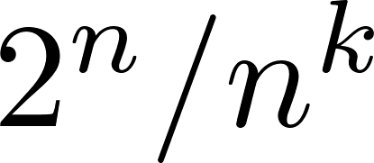
Williams’ Algorithmic Method
Williams (2010): To prove lower bounds against circuit class C, enough to develop
SAT algorithms for C-circuits.
Sufficient to design “non-trivial” algorithm:
running time << for every fixed k.
Williams (2011): NEXP (nondeterministic exponential time) is not contained in ACC⁰.
Hierarchy Thm + …
ACC⁰-SAT using known results about structure of ACC⁰ circuits.
New technique + Progress on lower bounds for stronger circuit classes.

Slide 10
Main drawbacks of Williams’ Thm
▶ Worst-case vs. Average-case Lower bounds:
Williams’ proof only gives a worst-case lower bound:
Language in NEXP such that every poly-size ACC⁰ circuit fails on some input.
Average-case lower bound:
Any small circuit is correct only on a ½ + o(1) fraction of n-bit inputs
Average-case hardness is a requirement for Cryptography, and has applications in other areas such as Derandomization.

Slide 11
Main drawbacks of Williams’ Thm
▶ Notion of explicitness is very weak: hard problem lies in NEXP.
P ⊆ NP ⊆ PH ⊆ PSPACE ⊆ EXP ⊆ NEXP
▶ Most existing lower bounds in circuit complexity are for functions in P or NP.
Desirable to get ACC⁰ lower bounds for EXP or at least
for classes believed to collapse to EXP.

Slide 12
Formal statement of results
+ discussion

Slide 13
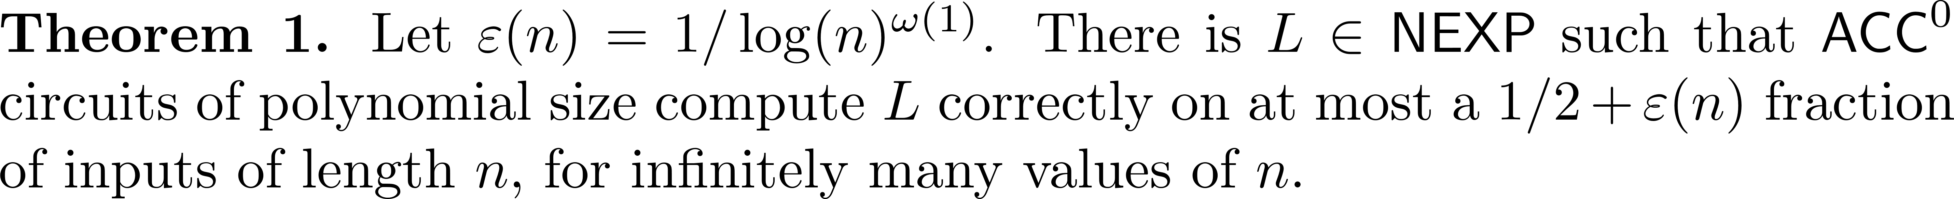
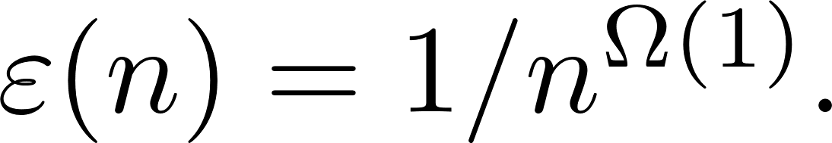
1. Average-case lower bound (Main Result)
For a hard language in E^{NP}, we can take

Slide 14
Towards more explicit lower bounds?
▶ We would like to get lower bounds for more explicit functions than NEXP (second drawback).
▶ In 2017, Oliveira and Santhanam proposed an analogue of Williams’ program for lower bounds that relies on LEARNING ALGORITHMS instead of SAT ALGORITHMS.
LEARNING gives lower bounds for randomized exponential time classes such as BPEXP and REXP. Under standard assumptions, such classes collapse to EXP.

Slide 15
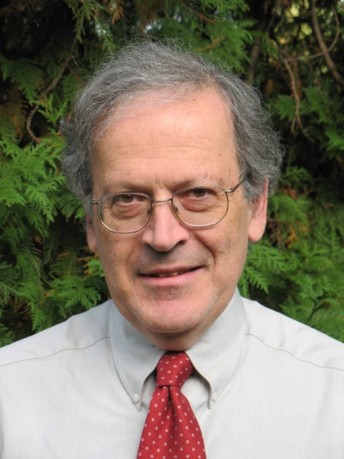
Learning Algorithms
Uniform Distribution, Randomized, Membership Queries.
PAC
ε: “Accuracy Parameter”.
(unknown) f in C
δ: “Confidence Parameter”.
Oracle Access
Goal:
Output with probability > 1 - δ a (general) circuit h such that
Pr_{x}[ h(x) = f(x) ] > 1 - ε.
Learning Algorithm A^{f}
Runs in time:
t_{A}(n, size(f), 1/ε, 1/δ)

Slide 16
Some learning algorithms
Circuit Class | Running Time | Reference
DNF, CNF | poly | Jackson, 1994
AC⁰ | quasi-poly | Linial-Mansour-Nisan, 1989
AC⁰[p] | quasi-poly | Carmosino et al., 2016
AC⁰[m], m composite
?

Slide 17
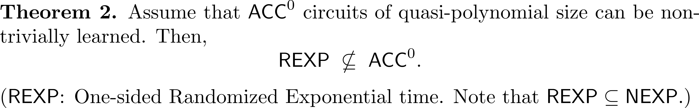
2. Learning Approach to ACC⁰ Lower Bounds
No Hierarchy Thm …
Definition. “Non-trivial learning algorithm”: Runs in time << 2^{n}/poly(n).
▶ Argument combines techniques from Williams (2011, 2013) and Oliveira-Santhanam (2017).

Slide 18
Some open problems
▶ Stronger average-case lower bounds for NEXP:
< ½ + 1/poly(n) for every polynomial (open even for AC⁰[2])
▶ (worst-case) Lower bounds against ACC⁰ for functions in EXP.
▶ Are ACC⁰ circuits learnable in non-trivial time?
(Satisfiability can be solved in non-trivial time)
Thanks / Gracias / Obrigado!

Slide 19
Overview of the average-case lb
(main ideas)

Slide 20
Worst-case to average-case:
A standard approach, and how it can fail
Williams’ worst-case lower bound proof doesn’t seem generalizable to average-case.
Hardness Amplification:
Transforms a function that is worst-case hard against C
Into a function that is average-case hard against C.
Sudan-Trevisan-Vadhan (2001):
view f as a string, use (local-list-decodable) error-correcting codes:
f → g = Encode(f)
Error rate close to 1/2
▶ A circuit D_{g} approximates g construct a circuit D_{f} that computes f

Slide 21
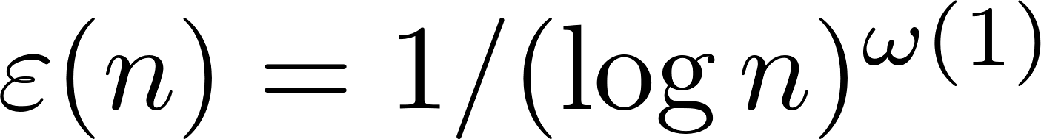
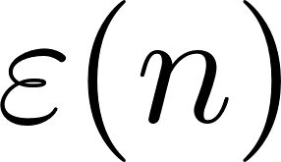
Obstacle 1. (“Psychological Barrier”)
It is known that “Black-box hardness amplification proofs require MAJ gates” (Shaltiel-Viola 2010).
Often conjectured that ACC⁰ cannot compute Majority.
We explore that our is not too small (connected to parameters of the code).
Construction of codes where fan-in of MAJ gates in decoder has good dependence on is known (Goldwasser et al. 2007, Gutfreund-Rothblum 2008).

Slide 22
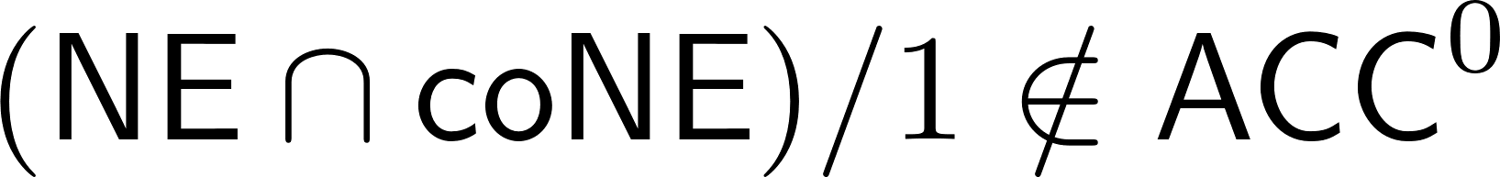

Obstacle 2. Applying error-correcting code to f in NEXP does not provide g in NEXP
(NEXP is not known to be closed under complement)
We use instead a more recent work of Williams (2013) showing that
Hardness amplification starting from a hard function f in
Possible to argue that g = Encode(f) is in

Slide 23
A final difficulty:
These ideas give a hard-on-average function computable with one bit of advice.
▶ A careful advice elimination argument allows us to complete the proof:
There is h in NEXP such that h is ½ + eps(n) average-case hard against ACC⁰.

