Slide 1
An Efficient Coding Theorem via Probabilistic Representations and Its Applications
Zhenjian Lu
Igor Oliveira
University of Warwick
ICALP 2021
Supported by a Royal Society University Research Fellowship

Slide 2
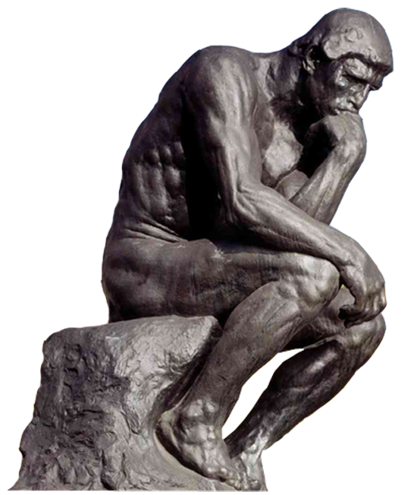



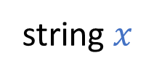

Which objects can be compressed?
string $x$
$$\text{short} \text{encoding} \text{of} x$$
$$01001101…0111010111$$
$$010001110$$
Kolmogorov Complexity:
$K\left(x\right)=$ minimum length of a program that prints $x$

Slide 3
In Algorithms and Complexity:
We would like to recover objects from their representations in bounded time.
Which objects admit short and effective representations?

Slide 4
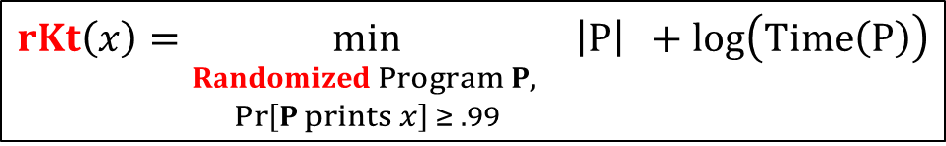
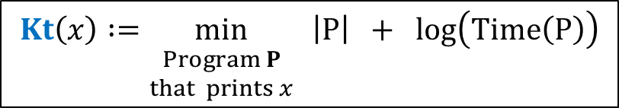



Time-bounded Kolmogorov complexity
[Levin’84]
[O’19] A randomized analogue:
$$Kt\left(x\right) :=\min_{\begin{aligned}. \\ Program P \\ that prints x\end{aligned}}{ \left|P\right| + \log\left(Time\left(P\right)\right)}$$
$$rKt\left(x\right)=\min_{\begin{aligned}. \\ Randomized Program P, \\ \operatorname{Pr}\left[P prints x\right] ≥ .99\end{aligned}}{ \left|P\right| +\log\left(Time\left(P\right)\right)}$$
short
effective
probabilistic representation of $x$
Many applications, but basic questions remain open:
Primes of small Kt complexity?
[OS’17, LOS’21] n-bit Primes of rKt complexity n^{ε}
Can we compute Kt($x$) in poly time?
[O’19] Computing rKt($x$) is not in BPP.

Slide 5




Pillars of Kolmogorov Complexity
Time-bounded version?
Language Compression Theorem
Hardness Assumption
$$K\left(x\right)≤\left|L∩{\left\{0,1\right\}}^{n}\right|+O(log{n)}$$
Symmetry of Information
Hardness Assumption
$$K\left(x,y\right)≈K\left(x\right)+K\left(y|x\right)≈K\left(y\right)+K\left(x|y\right)$$
?
Coding Theorem
“Samplable objects have short representations”:

Slide 6
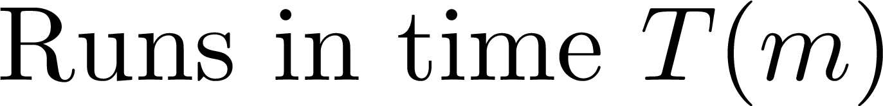

This Work: An Efficient Coding Theorem for rKt
“Efficiently Samplable objects admit short and effective probabilistic representations.”
Theorem
Efficient generation of representation: Given $x,A,m$ and $δ$, w.h.p, we can compute in time $poly(|x|)$ an $rKt$ representation of $x$ with complexity $k=O(\log\left(1/δ\right)+\log{T}+\log{m})$.
Program P that runs in time $t$ and prints $x$ w.h.p such that $\left|P\right|+\log{t}≤k$.
Extremely useful
in applications!
“Magic”: Running time does not depend on $T$.

Slide 7



Thank you!
Applications
1. Polynomial time instance-wise search-to-decision reduction
2. Equivalence between probabilistic representations and samplability
3. Strong time hierarchy for sampling distributions (conditional)

