Slide 1
Conspiracies between Learning Algorithms,
Lower Bounds, and Pseudorandomness
Igor Carboni Oliveira
University of Oxford
Joint work with Rahul Santhanam (Oxford)

Slide 2
Context
Minor algorithmic improvements imply lower bounds (Williams, 2010).
NEXP not contained in ACC⁰ (Williams, 2011), and extensions.

Slide 3
This Work
Analogue of Williams’ celebrated lower bound program in Learning Theory.
Combining and extending existing connections.
Further applications of the “Pseudorandom Method”:
Hardness of MCSP,
Karp-Lipton Theorems for BPEXP.
etc.

Slide 4
Lower bounds from learning

Slide 5
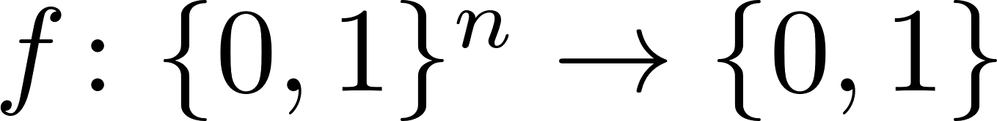


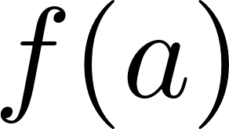

Learning Model (Randomized, MQs, Uniform Dist.)
A Boolean circuit class C is fixed.
from C[s(n)] is selected.
Randomized
Algorithm
Learner must output w.h.p a hypothesis such that:

Slide 6
Some learning algorithms
Combinatorial lower bounds
Lower bounds are unknown, or obtained via diagonalization
[Jac97] DNFs can be learned in polynomial time.
Harmonic-Sieve/Boosting
[LMN93] AC⁰ circuits learnable in quasi-polynomial time.
Fourier Concentration
[CIKK16] AC⁰[p] learnable in quasi-polynomial time.
Pseudorandomness/Natural Property

Slide 7
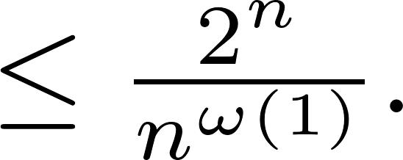
Can we learn AC⁰ circuits with Mod 6 gates in sub-exponential time?
As far as I know, open even for:
AND o OR o MAJ circuits, MOD₂ o AND o THR circuits.
Definition. Non-trivial learning algorithm:
▶ Runs in randomized time
▶ For every function f in C:

Slide 8
Theorem. Let C be any subclass of Boolean circuits closed under restrictions.
Example: C = (depth-6)-ACC⁰, AND o OR o THR, etc.
If for each k>1, C[n^{k}] admits a non-trivial learning algorithm, then for each k > 1, BPE is not contained in C[n^{k}].
Non-trivial learning implies lower bounds
Let BPE = BPTIME[2^{O(n)}].

Slide 9
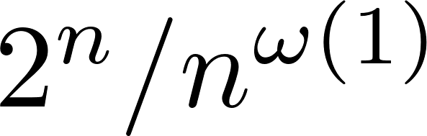
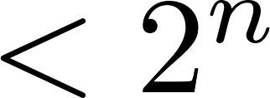
LBs from Proofs, Derandomization, Learning
 | Non-trivial SAT/Proof System | Non-trivial Derandomization | Non-trivial Deterministic Exact Learning | Non-trivial Randomized Learning
Assumption | Proofs checked in deterministic time | Algorithm runs in deterministic time | Learner runs in deterministic time | Learner runs in randomized time
Consequence | LBs for NEXP | LBs for NEXP | LBs for EXP | LBs for BPEXP
Reference | [Wil10] | [Wil10], [SW13] | [KKO13] | [This Work]

Slide 10
Remarks on lower bounds from Learning
▶ Learning approach won’t directly work for classes containing PRFs.
▶ Conceivable that one can design non-trivial learning algorithms for a class C under the assumption that BPEXP is contained in P/poly.
▶ Learning connection applies to virtually any circuit class of interest, and there is no depth blow-up.
It can lead to new lower bounds for restricted classes such as THR o THR and ACC⁰.

Slide 11
Previous work on learning vs. lower bounds
▶ Systematic investigation initiated about 10 years ago:
[FK06] Lower bounds for BPEXP from polynomial time learnability.
[HH11] Lower bounds for EXP from deterministic exact learning.
[KKO13] Optimal lower bounds for EXP from deterministic exact learning.
[Vol14] Lower bounds for BPP/1 from polynomial time learnability.
[Vol’15] Further results for learning arithmetic circuits.

Slide 12
A Challenge in Getting Lower Bounds from Randomized Learning
Williams’ lower bounds from non-trivial SAT algorithms: a non-trivial algorithm can be used to violate a tight hierarchy theorem for NTIME.
Challenge in Randomized Learning:
lack of strong hierarchy theorems for BPTIME.
The approach has to be indirect, and we must do something different ...

Slide 13

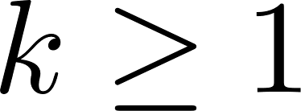
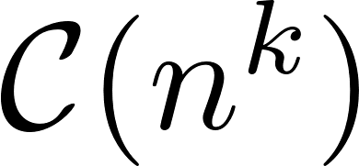


Speedup Phenomenon in Learning Theory
Speedup Lemma. Let be any class of Boolean circuits containing AC⁰[2].
Suppose that for each the class admits a non-trivial learning algorithm.
Then for each and , the class is strongly learnable in time

Slide 14
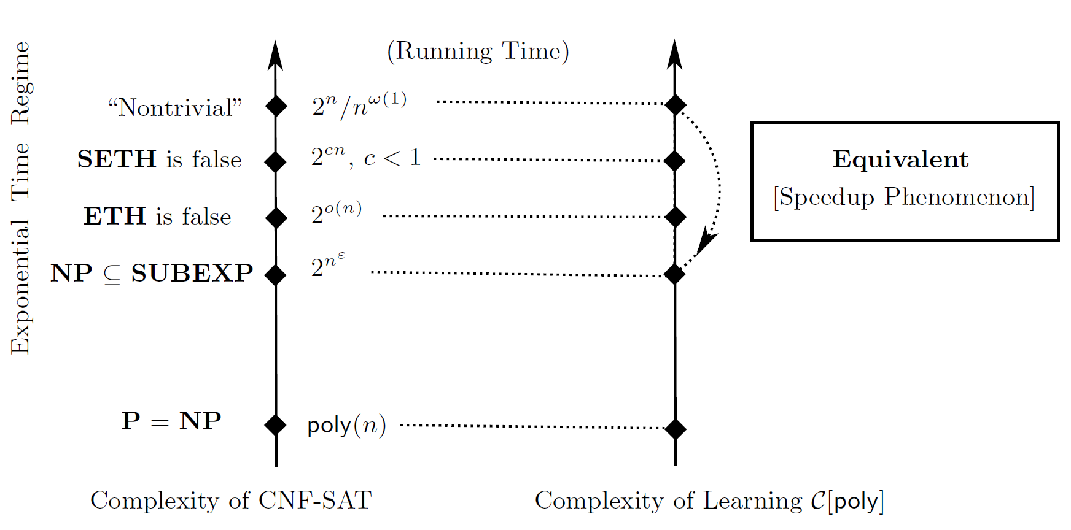
SAT Algorithms vs. Learning Algorithms

Slide 15

Main Techniques: “Speedup Lemma”
Non-trivial Learner
+
NW-Generator
+
Hardness Amplification
Faster Learner!
1. Given oracle access to in C[poly], implicitly construct a “pseudorandom” ensemble of functions in C[poly] on n^{δ} bits.
(using NW-generator + Hardness Amplification [CIKK16])
Intuition: Non-trivial learner can distinguish this ensemble from random functions. This can be done in time
2. This distinguisher (i.e. the non-trivial learner) and the reconstruction procedures of NW-generator and Hardness Amplification can be used to strongly learn in time

Slide 16
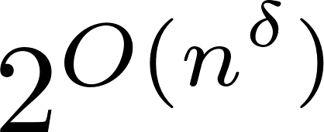

Main Techniques: “LBs from Learning”
1. Starting from non-trivial learner, apply the Speedup Lemma to obtain a sub-exponential time learner.
Speedup
2. Adapting the techniques from [KKO13],
randomized sub-exponential time learnability of C[poly] implies BPE lower bounds against C[n^{k}].
3. Using an additional win-win argument, this holds under minimal assumptions on C, and with no blow-up in the reduction.

Slide 17
Combining and extending existing connections

Slide 18

Nontrivial SAT /
ACC⁰ lower bounds [Wil11]
NEXP
EXP
ZPEXP
REXP
MAEXP
Well-known connection to PRGs/ derandomization of BPP [IW97]
P/poly lower bounds [BFT98]
BPEXP
Non-trivial learning [This work]
[OS17] Connections to pseudo-deterministic algorithms.
▶ Further motivation for the following question:
Which algorithmic upper bounds imply lower bounds for ZPEXP and REXP, respectively?

Slide 19
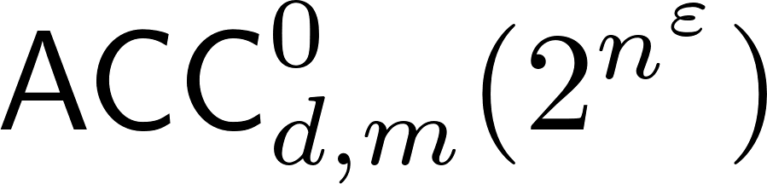

One-sided error: Lower bounds for REXP
We combine the satisfiability and learning connections to lower bounds to show:
[ Informal ]
If a circuit class C admits both non-trivial SAT and non-trivial Learning then
REXP is not contained in C.
Corollary. [ACC⁰ lower bounds from non-trivial learning]
If for every depth d>1 and modulo m>1 there is such that
has non-trivial learning algorithms, then
Indicates that combining the two frameworks might have further benefits.

Slide 20
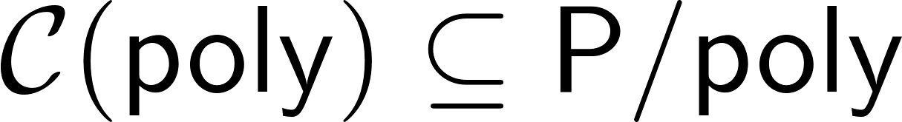

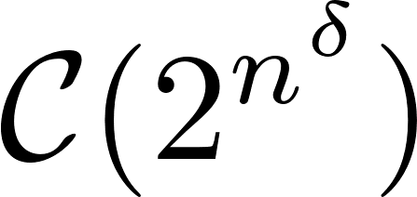

Zero-error: Lower bounds for ZPEXP
[IKW02], [Wil13] Connections between natural properties without density condition, Satisfiability Algorithms, and NEXP lower bounds.
[CIKK16] Connections between BPP-natural properties and Learning Algorithms.
We give a new connection between P-natural properties and ZPEXP lower bounds.
Let be a circuit class closed under restrictions.
Theorem. [ZPEXP lower bounds from natural properties]
If for some there are P-natural properties against then

Slide 21
Further Applications of our Techniques

Slide 22
A rich web of techniques and connections
Learning speedup
Karp-Lipton collapses
“Pseudorandom Method”
Hardness of MCSP
LBs from Learning
Use of (conditional) PRGs and related tools, often in contexts where (pseudo)randomness is not intrinsic.

Slide 23

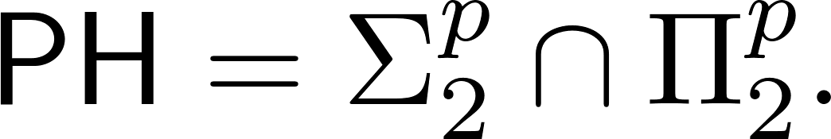
Karp-Lipton Collapses
Connection between uniform class and non-uniform circuit class:
[KL80] If then
Assumption | Consequence | Major Application
EXP in P/poly | EXP = MA [BFT98] | MA_{EXP} not in P/poly [BFT98]
NEXP in P/poly | NEXP = EXP [IKW02] | SAT / LB Connection [Wil10]
Randomized Exponential Classes such as BPEXP ?

Slide 24
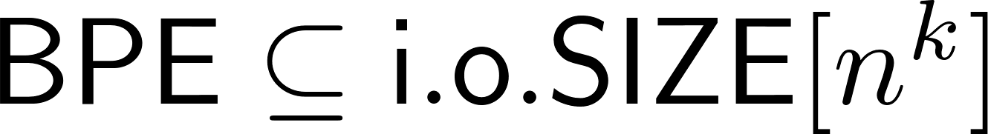

Karp-Lipton for randomized classes
Theorem 1. If then
The advice is needed for technical reasons. But it can be eliminated in some cases:
Theorem 2. If then
▶ Check paper for Karp-Lipton collapses for ZPEXP, and related results.

Slide 25
Hardness of MCSP
Minimum Circuit Size Problem:
Given 1^{s} and a Boolean function represented as an N-bit string,
Is it computed by a circuit of size at most s?
Recent work on MCSP and its variants: [KC00], [ABK+06], [AHM+08], [KS08], [AD14], [HP15], [AHK15], [MW15], [HP15], [AGM15], [HW16].
!
[ABK+06] MCSP is not in AC⁰.
Open. Prove that MCSP is not in AC⁰[2]

Slide 26
Theorem. If MCSP is in TC⁰ then NC¹ collapses to TC⁰.
Our result
We prove the first hardness result for MCSP for a standard complexity class beyond AC⁰:
The argument describes a non-uniform TC⁰ reduction from NC¹ to MCSP via pseudorandomness.

Slide 27
Additional applications of our techniques
▶ Equivalences between truth-table compression [CKK+14] and randomized learning models in the sub-exponential time regime.
(For instance, equivalence queries can be eliminated in sub-exp time randomized learning of expressive concept classes.)
▶ A dichotomy between Learnability and Pseudorandomness in the
non-uniform exponential-security setting:
“A circuit class is either learnable or contains pseudorandom functions, but not both.”
In other words, learnability is the only obstruction to pseudorandomness.
(Morally, ACC⁰ is either learnable in sub-exp time or contains exp-secure PRFs.)

Slide 28
Problems and Directions
Is there a speedup phenomenon for complex classes (say AC⁰[p] and above) for
learning under the uniform distribution with random examples?
Can we establish new lower bounds for modest circuit classes by designing non-trivial learning algorithms?

Slide 29
Towards lower bounds against NC?
Non-trivial learning implies lower bounds:
First example of lower bound connection from non-trivial randomized algorithms.
Problem. Establish a connection between non-trivial randomized SAT algorithms and lower bounds.
(First step in a program to obtain unconditional lower bounds against NC.)

Slide 30
Thank you

