Slide 1

Extracting computational hardness from classical and quantum learning algorithms
Igor Carboni Oliveira
University of Warwick
MIT Algorithms & Complexity Seminar
20 April 2022
A. Klivans and P. Kothari
Based in part on joint papers with
R. Santhanam
S. Arunachalam, A. Grilo, T. Gur, and A. Sundaram
Funded by the Royal Society
1

Slide 2
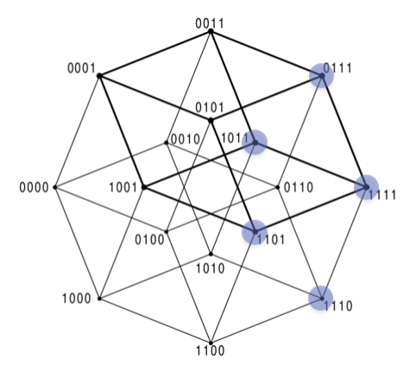
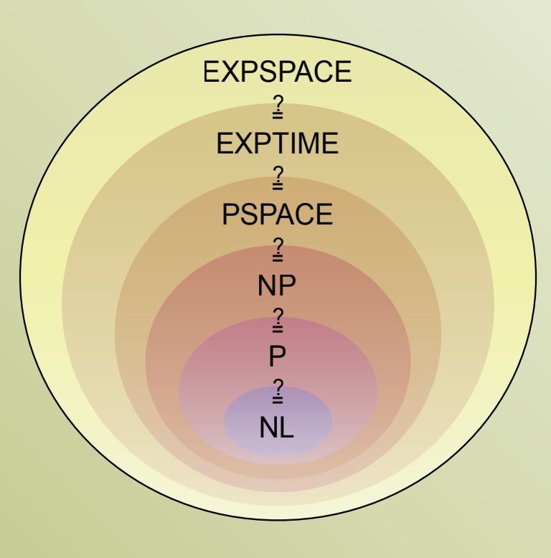

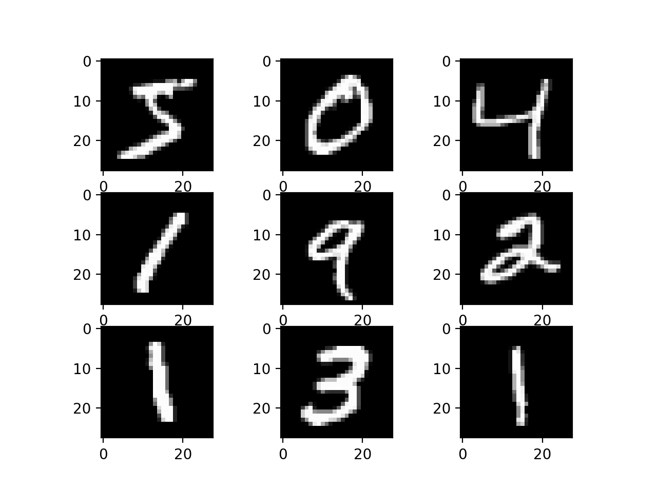


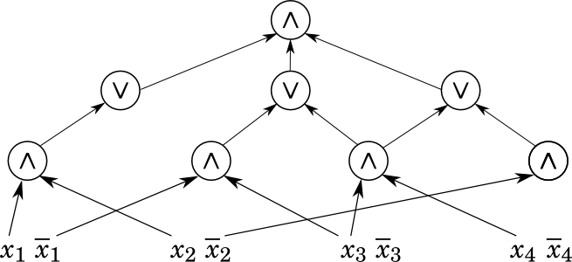
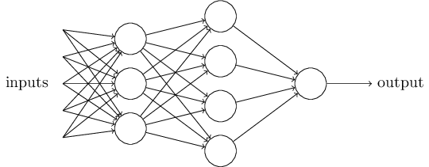
Learning Theory
Complexity Theory
unknown function
P vs BPP
labelled inputs (data)
CACM March/21
learning algorithm
Power of quantum computing
2

Slide 3

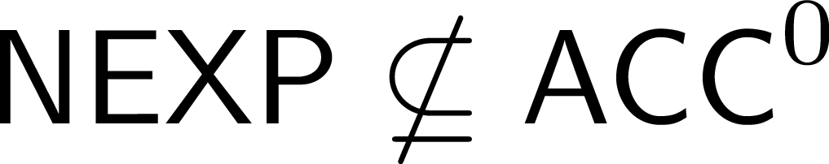


Algorithms
Complexity Theory
Positive results:
Design of faster algorithms
Impossibility results:
no efficient algorithm or computing device
[Williams 2011]
[CIKK 2016]
This talk:
Complexity lower bounds from learning algorithms
First general connection between the design of quantum algorithms and circuit lower bounds
3

Slide 4

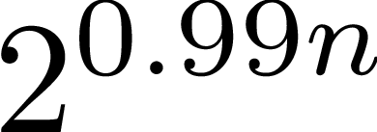
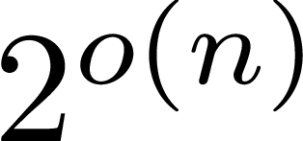

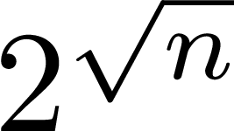
Results
deterministic
randomized
quantum
Any marginal improvement on ``trivial’’ learning algorithms implies breakthrough circuit lower bounds
4

Slide 5







Main references for this talk
Deterministic
Constructing hard functions from learning algorithms [Klivans-Kothari-O] – CCC’13
Conspiracies between learning algorithms, circuit lower bounds, and pseudorandomness [O-Santhanam] – CCC’17
Randomized
Randomness and intractability in Kolmogorov complexity [O] – ICALP’19
Quantum learning algorithms imply circuit lower bounds [Arunachalam-Grilo-Gur-O-Sundaram] – QIP’21/FOCS’21
Quantum
Many other interesting papers not covered in this talk (e.g., Volkovich’16, Chen-Rothblum-Tell-Yogev’20, …)
5

Slide 6
Boolean Circuits and Complexity Theory
6

Slide 7
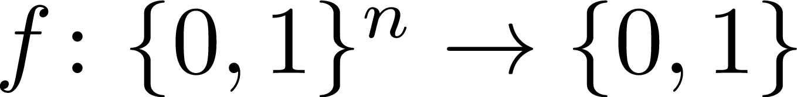


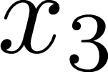

Boolean Circuits
Depth d = 3
AND
Size s = 6
AND
OR
OR
NOT
XOR
7

Slide 8
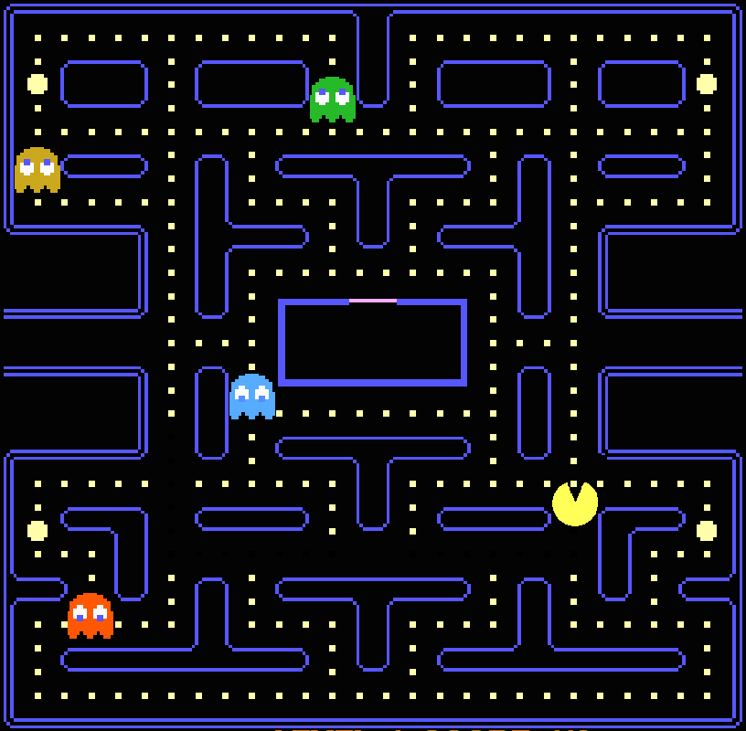

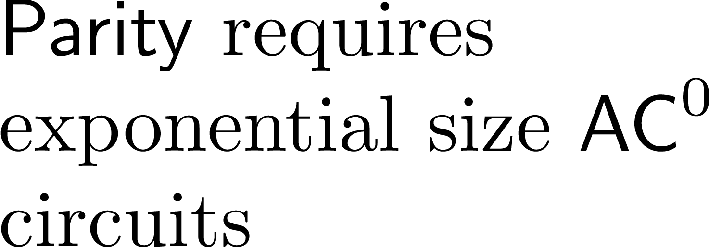
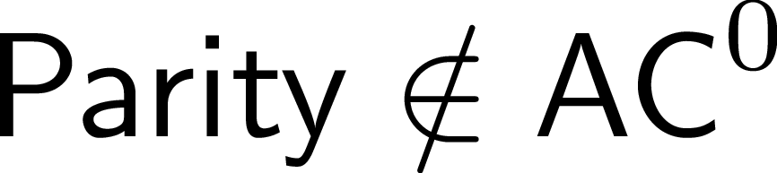


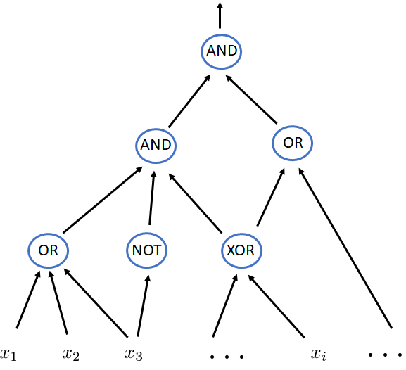
Back in the 80’s
Many exciting circuit lower bounds!
Ajtai
Furst-Saxe-Sipser
Razborov
Yao, Hastad
Razborov, Smolensky
‘83
‘84
‘85
‘87
‘87
A solution to P vs NP must be in the horizon…
8

Slide 9


Since the 90’s
Progress has slowed down…
Still widely believed that
But consistent with current knowledge that:
9

Slide 10
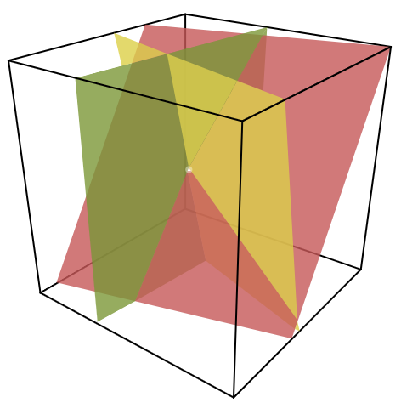
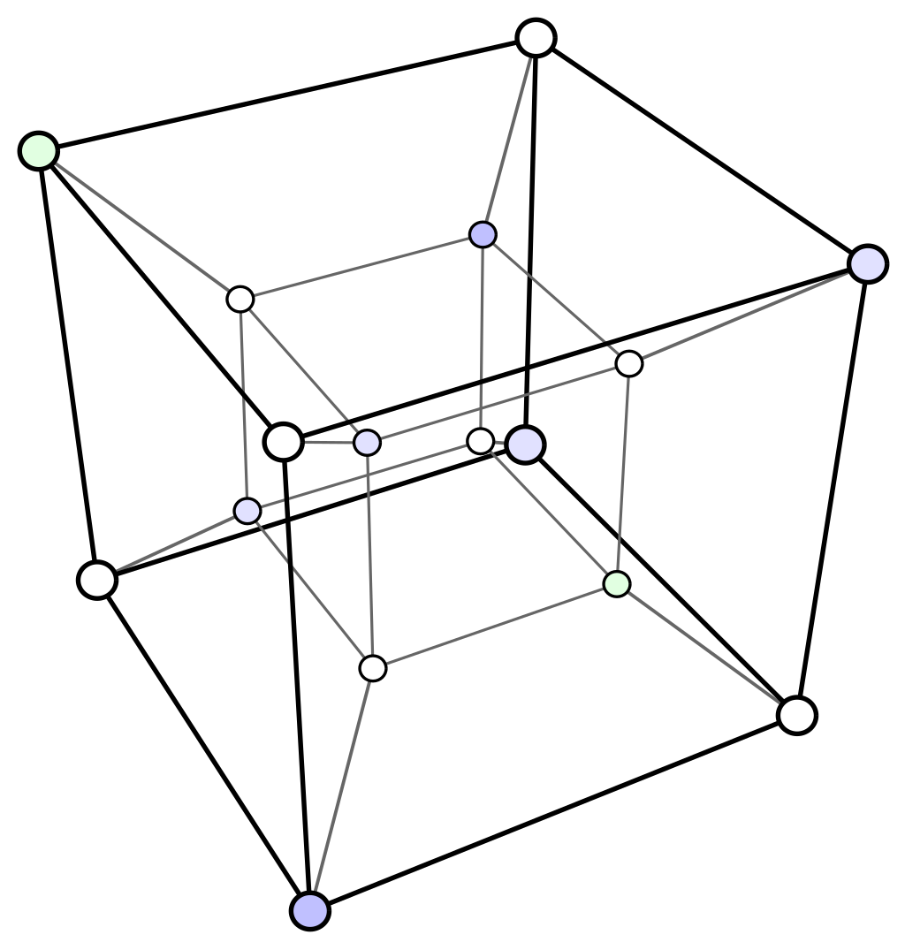
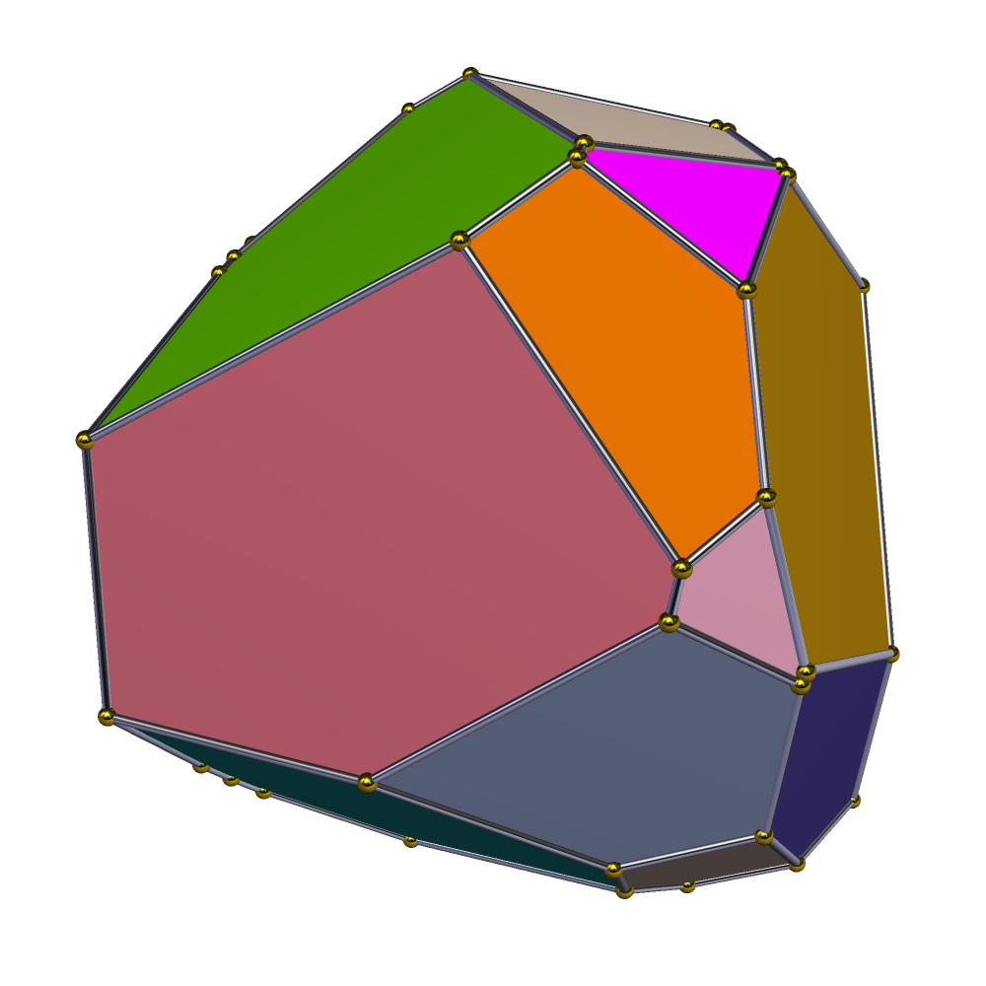

A frontier: Threshold circuits
THR
Can two layers of polynomially many THR gates simulate exponential time algorithms?
THR
THR
THR
THR
10

Slide 11
Learning Algorithms
11

Slide 12
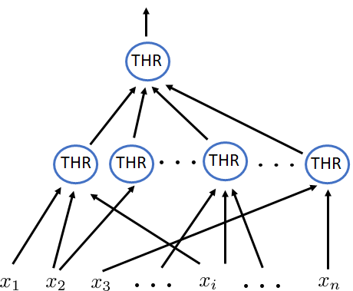


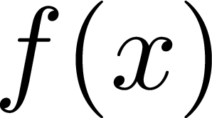
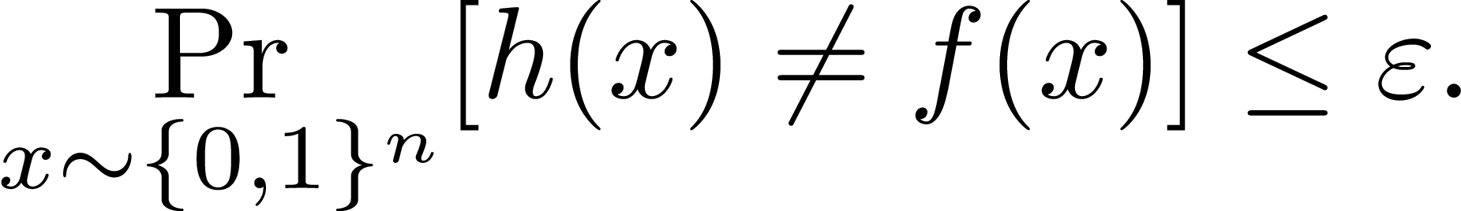


Learning Theory
For our results: the stronger the model, the better!
12

Slide 13
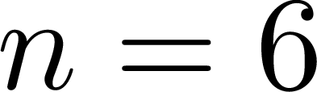
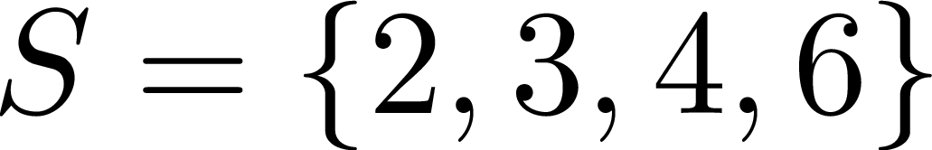

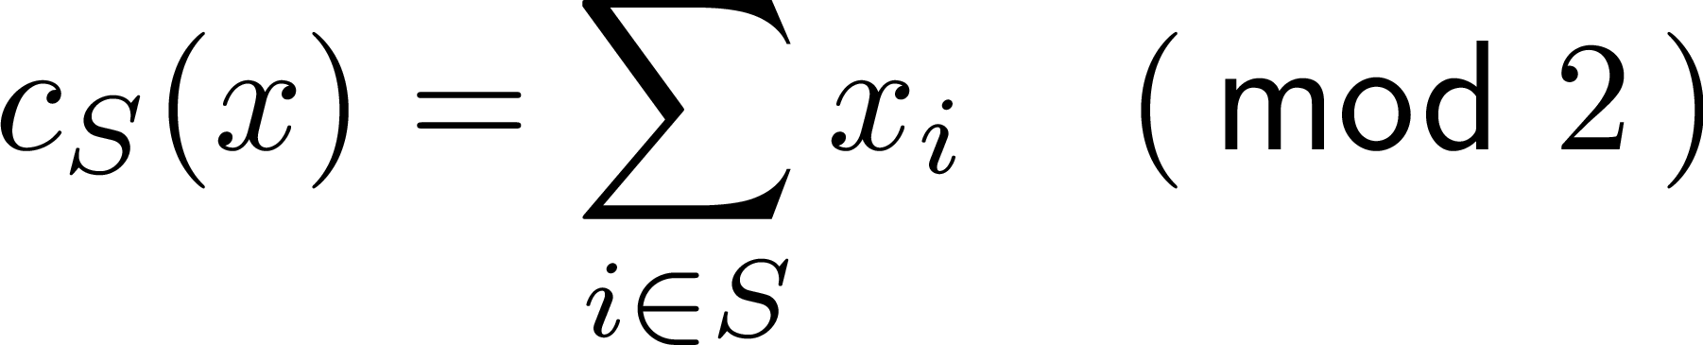
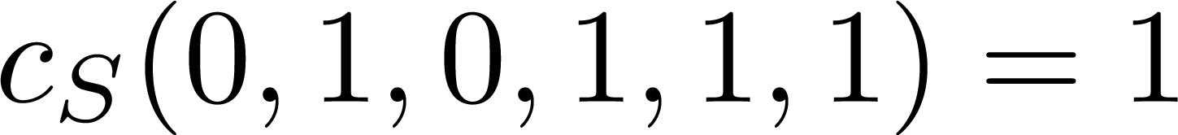




Example: Learning an unknown parity
13

Slide 14

Example: learning an arbitrary THR gate
See e.g. [BEHW’89]
14

Slide 15







Learning expressive classes of functions
Some significant achievements:
computational power
Cryptographic hardness
e.g. Factoring is hard
Linial-Mansour-Nisan
CIKK
‘16
Jackson
‘94
‘89
no lower bound
&
no learning algorithm…
15

Slide 16
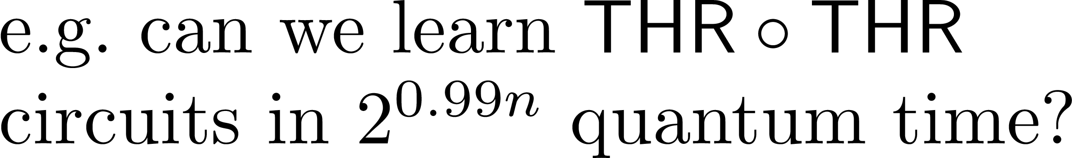
Can quantum algorithms help?
Extension of the model:
Quantum query access
to unknown function:
+
Quantum computation to process the data
Similar Goal:
Quantum learners: potentially more powerful than deterministic/randomized learners!
Can we achieve quantum learning speedups?
16

Slide 17
Computational Hardness from Learning Algorithms
17

Slide 18
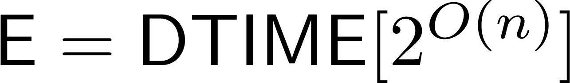
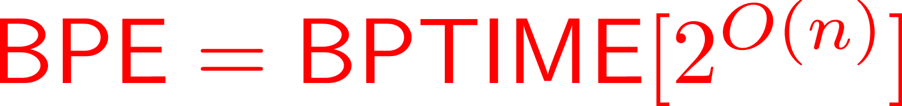
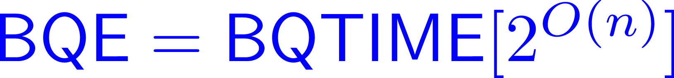
Results
First general connection between quantum algorithm design and complexity lower bounds.
18

Slide 19
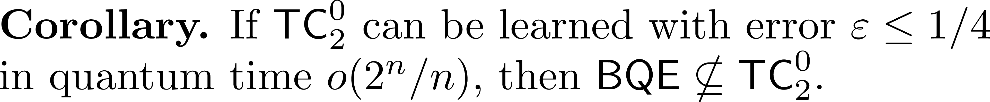
A concrete example
Minor algorithmic progress would lead to major progress in complexity theory!
19

Slide 20
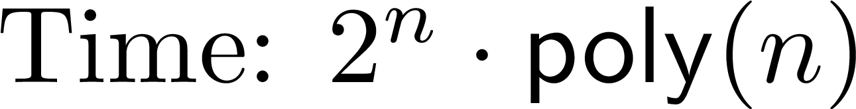
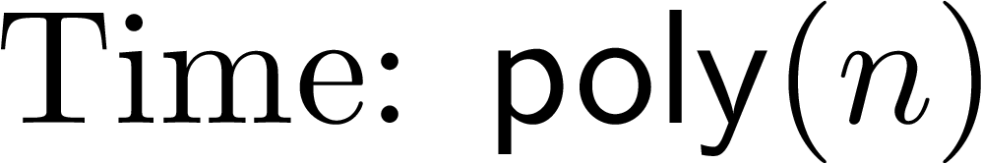

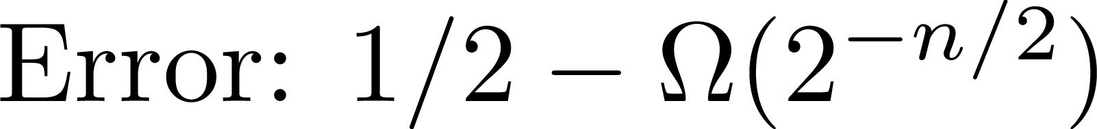
Tightness of the result
Consider 2 ``trivial’’ quantum learners:
1) Query everything (classical)
2) Fourier sampling (quantum)
Our result: Non-trivial quantum learners
circuit lower bounds
20

Slide 21
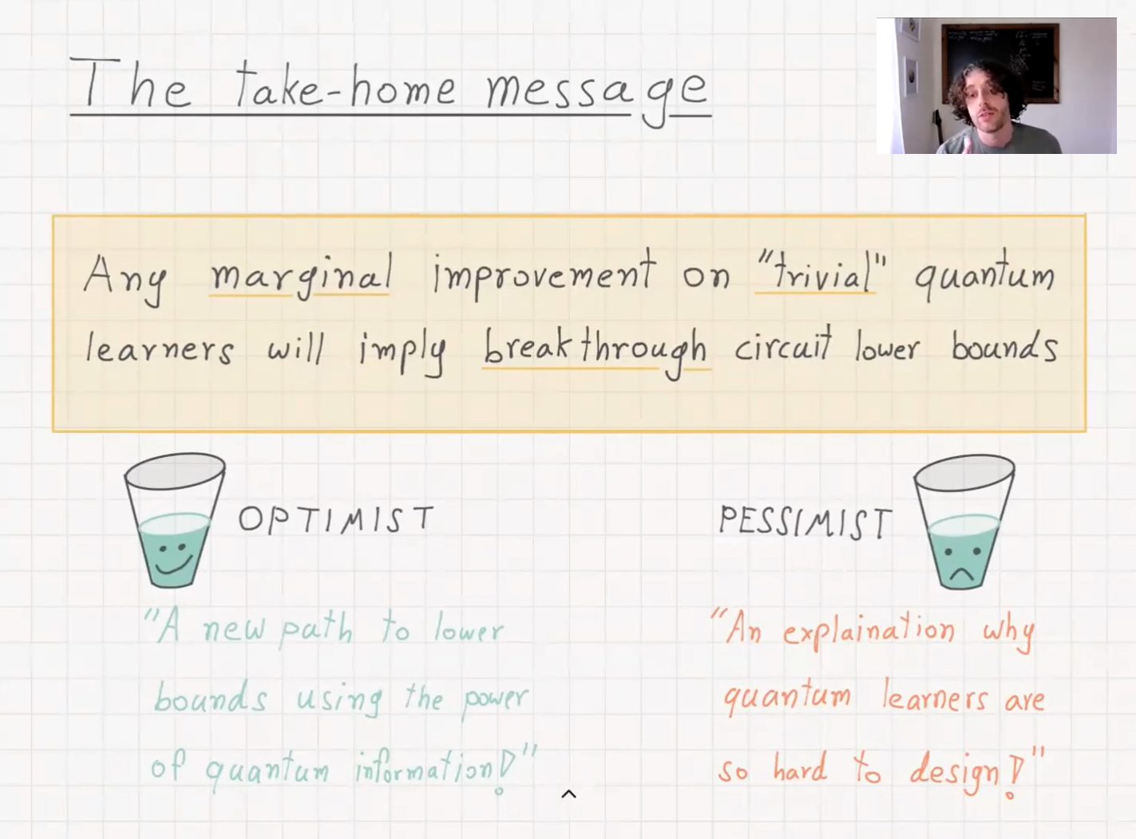
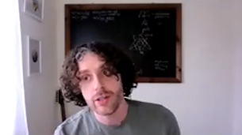
21

Slide 22
Techniques
22

Slide 23
Techniques:
Extracting hard functions from learning algorithms
Deterministic learner
Randomized learner
Quantum learner
Obtaining lower bounds from learner becomes more delicate
[KKO’13]
[OS’17]
[AGGOS’21]
2 stages:
A new modular approach via PRGs
Elementary proof
learning speedups via [CIKK’16]
+ extension of [KKO’13]
Conceptually simpler, but PRG construction requires work
via [OS’18]
23

Slide 24

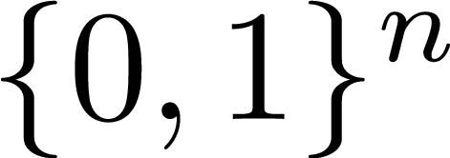

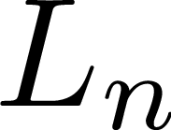
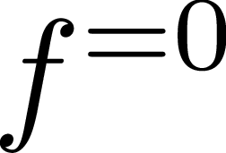



Deterministic learners with MQs
24

Slide 25

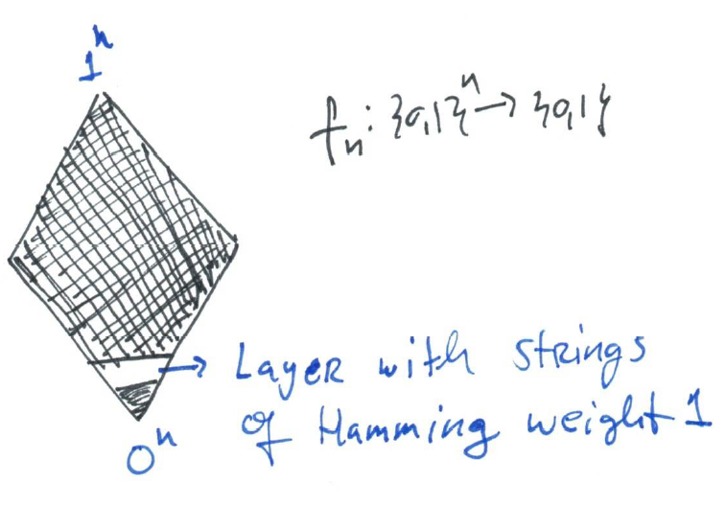
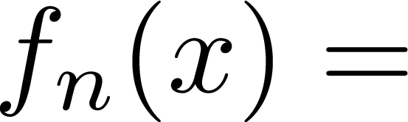

Example: Learner with MQs for the concept class of parities
25

Slide 26
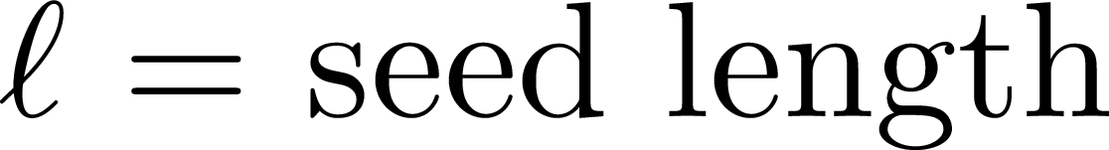
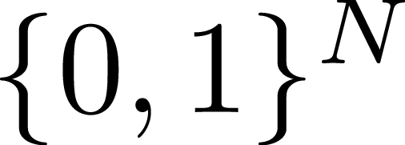

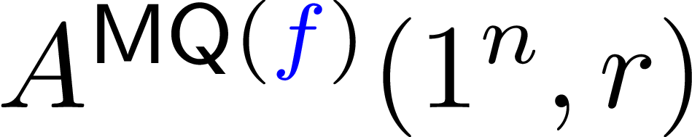

Randomized and Quantum learners
[AGGOS’21]
Previous approach doesn’t work!
x
x
x
x
x
x
x
x
x
x
[OS’18] To derandomize learners, PRGs against (non-uniform) circuits are sufficient.
We don’t have such PRGs...
[AGGOS’21]
New idea: Use PRG in a different way. (It will be enough to have PRGs against uniform computations.)
26

Slide 27




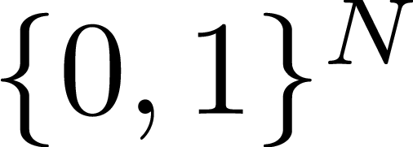
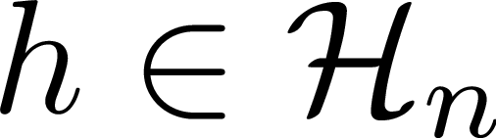

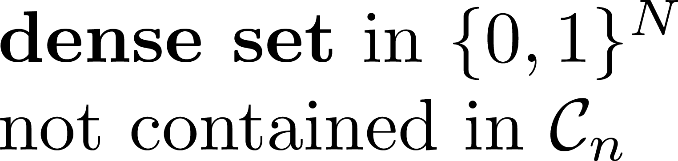




Proof overview
Simplifying assumption.
27

Slide 28

x
x
x
x
x
x
x
x
x
x
Sketch omits subtle issues.
Check paper for details!
28

Slide 29

Difficulties in the quantum setting
Analysis of the PRG is technically delicate:
Randomized algorithms: often reduces to deterministic case.
“Quantumness” is inherent and cannot be eliminated!
Extension of local-list decoding algorithm of [IJWK’11] to quantum circuits requires delicate analysis
29

Slide 30
Example: Randomized versus Quantum
An important component of PRG constructions is hardness amplification
[IJWK’11]
Quantum D’?
Randomized D’:
Can fix the randomness and reduce to deterministic case
30

Slide 31
Application:
Intractability in time-bounded Kolmogorov complexity
31

Slide 32



Exploring the learning-to-lower-bound connection
[O’19]
yes
no
[O’19] A natural problem in time-bounded Kolmogorov complexity satisfies both conditions!
32

Slide 33
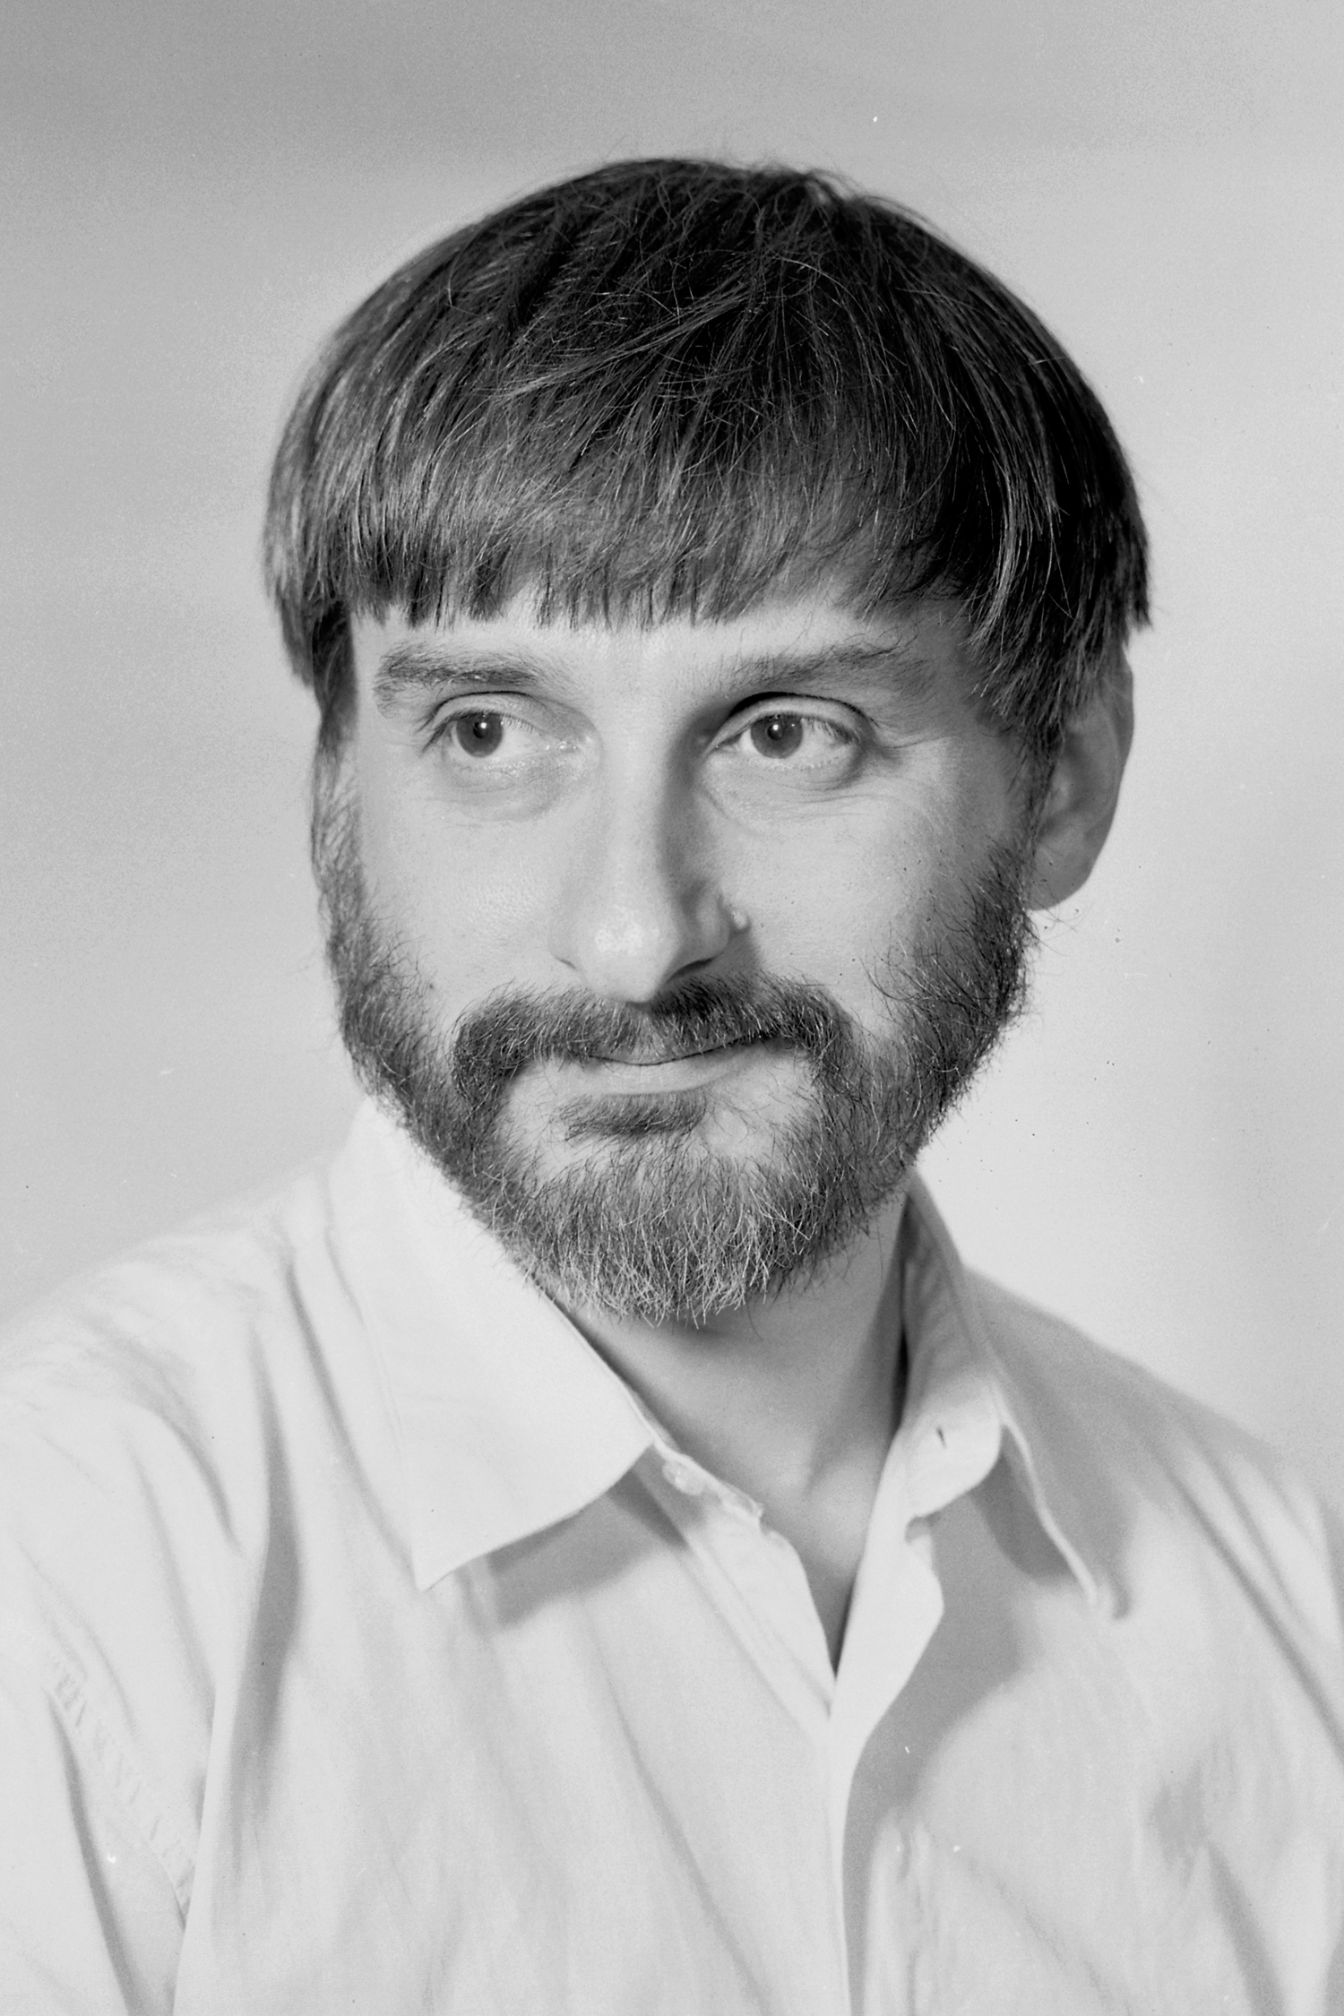
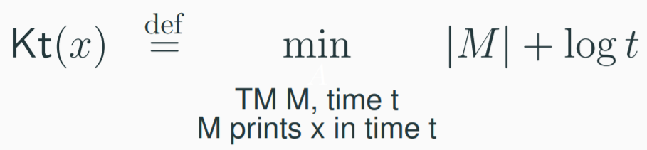
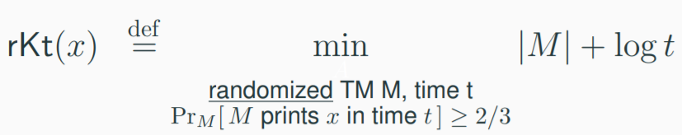

Time-bounded Kolmogorov complexity
Levin (1984) proposed the following notion of complexity for strings.
Longstanding open problem:
Show that estimating Kt is not in P.
short
effective
[O’19] Estimating rKt is not in BPP.
33

Slide 34

Concluding Remarks
Designing non-trivial learning algorithms circuit lower bonds
Exploring this connection in an indirect way has led to new complexity lower bounds
Can we get new circuit lower bounds through a direct application of this framework?
Non-trivial learning algorithms are known for several classes of circuits:
34

Slide 35

Question
35

Slide 36
Thank you!
36

