Slide 1
Hardness Magnification
Igor Carboni Oliveira
University of Oxford / Simons Institute
Boolean Devices Workshop
Talk based on joint work with Rahul Santhanam (Oxford)

Slide 2
Satisfiability Derandomization
Learning, etc.
Non-trivial Algorithms
super-polynomial
lower bounds
This talk:
“Hardness Magnification”
Non-trivial Lower Bounds
super-polynomial
lower bounds

Slide 3
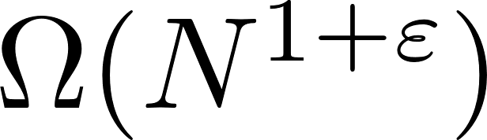
Magnification of weak lower bounds
Strong lbs: hard to prove.
Weak lbs: known in many contexts, such as formulas size.
“Magnification”: result showing that a lower bound of the form
for a certain problem implies super-polynomial lower bounds.
Approach seems to avoid the natural proofs barrier.

Slide 4
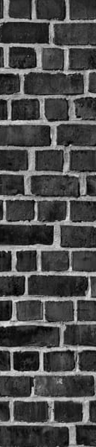
“Weak” and “Strong” Circuit Classes
Strong: no lower bounds
Weak: explicit lower bounds
Conjectured to be able
to compute PRFs
NC¹
AC⁰[p]
MAJ-MAJ-MAJ
BRANCH-PROGRAM[poly]
AC⁰
FORMULA[N³]
TC⁰
P/poly
BRANCH-PROGRAM[N²]
ACC⁰
MAJ-MAJ
Natural Proofs
Barrier

Slide 5
How to avoid natural proofs?
Natural Property: An algorithm satisfying the following properties:
Constructivity: Runs in time polynomial in N (input length).
X
Largeness: Accepts most input strings in {0,1}^{N}.
Usefulness: Rejects every string in {0,1}^{N} representing a function computable by poly(n) size devices.
NEXP not contained in a class C
roughly equivalent to
existence of property that is constructive and useful against C.
(Williams 2013)

Slide 6
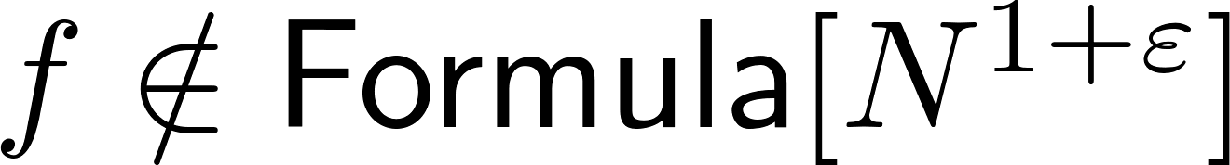
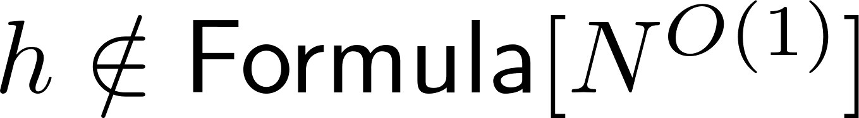
Hardness Magnification and Natural Proofs
Magnification applies to specific problems!
Unclear how to extract from
weak lower bound + magnification
a property showing hardness of most Boolean functions.

Slide 7
Previous Work

Slide 8
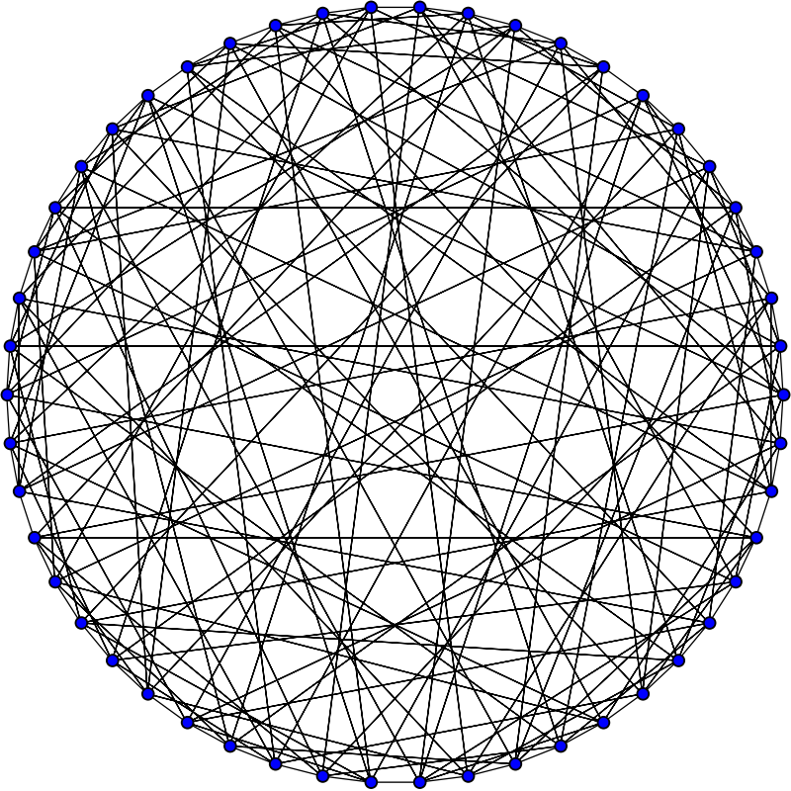
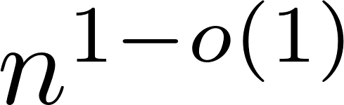
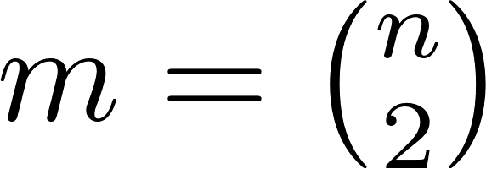
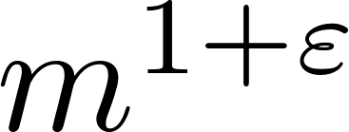
Srinivasan (2000)
▶ Considers randomized RAM model, and
-approximation problem for CLIQUE.
Input length:
Picture: Wikipedia
▶ Proves several results showing that lower bounds imply separations such as NP not contained in BPP.

Slide 9
Allender and Koucky (2008)
Theorem. There is an NC¹-complete language L such that if L is not in TC⁰(n^{1.001})
then L is not in TC⁰(n^{k}) for all k (and NC¹ is not contained in TC⁰).
Lipton and Williams (2012)
Magnification of SIZE-DEPTH lower bounds for CIRCUIT-EVAL:
Theorem. If CIRCUIT-EVAL is not in SIZE-DEPTH[n^{1.001}, n^{1 - o(1)}],
then for every k CIRCUIT-EVAL is not in SIZE-DEPTH[n^{k}, n^{o(1)}].

Slide 10
Required lower bounds are unknown.
Open if NE is contained in TC⁰[n^{1+ eps}].
Not clear how to get size-depth trade-offs for a function in P.
Can we prove interesting magnification results in settings where we do have lower bounds?

Slide 11
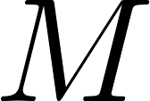
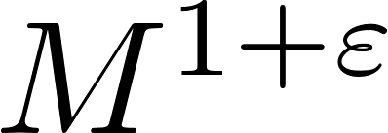
Muller and Pich (2017)
Previously investigated;
LBs in very weak systems are known.
(Razborov)
Theorem. If certain tautologies of size require bounded-depth Frege proofs of size
, then we get super-polynomial size Frege lower bounds.
Lower bounds are known, but for different tautologies (Ajtai)
Are there similar results in circuit complexity?

Slide 12
Our Results

Slide 13
Our results
▶ Magnification is a broad phenomenon that holds in a variety of contexts.
▶ Crucially, magnification in settings where there are unconditional lower bounds.
▶ We observe a few closely related lower bounds. Evidence that some of these problems can be analysed using known techniques.

Slide 14
List of Problems
To establish magnification as a fairly general phenomenon, we consider a range of computational problems of interest:
1. Variants of the Minimum Circuit Size Problem (MCSP)
2. The Vertex Cover problem
3. Satisfiability (3-SAT)

Slide 15
Summary
For each problem Q, we show:
(a) An implication from a weak lower bound for Q to a strong lower bound for an explicit problem.
(b) Under a standard hardness hypothesis, the weak lower bound for
Q does hold (and indeed a much stronger one).
(c) The weak lower bound is barely non-trivial. In most cases, it is
known for some problem, just not for the problem Q we consider.

Slide 16
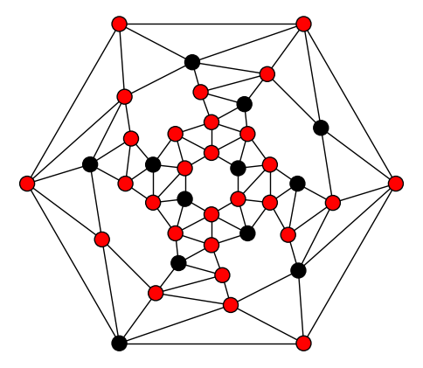
k-Vertex-Cover
The red vertices form a vertex cover.
Picture: Derrick Stolee

Slide 17
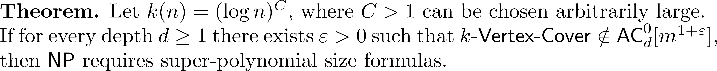
Magnification from AC⁰ lower bounds
AC⁰ circuits: Poly-size constant-depth circuits containing AND/OR/NOT gates.
Known to be extremely limited - [Ajtai], [FSS], etc. Results from the 80s.
Cannot even compute Parity over m input bits!
“Hardness Certificate”:
Under ETH the complexity should be exp(k) >> poly(n).

Slide 18
The Minimum Circuit Size Problem (MCSP)
Average-case variant

Slide 19
Magnification around linear-size formula lbs
One-sided variant
“Hardness Certificate”:
Under standard cryptographic assumptions, the problem requires circuits of super-poly size.

Slide 20
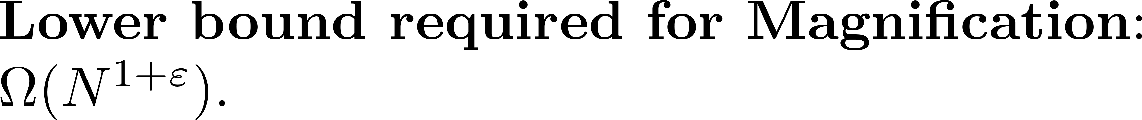
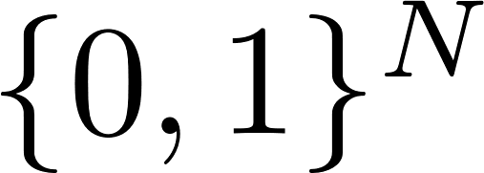
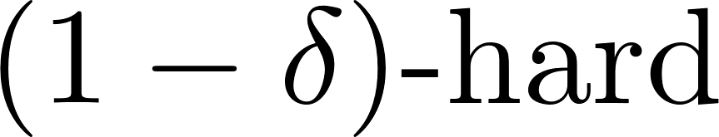
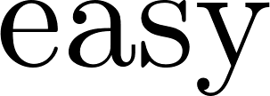
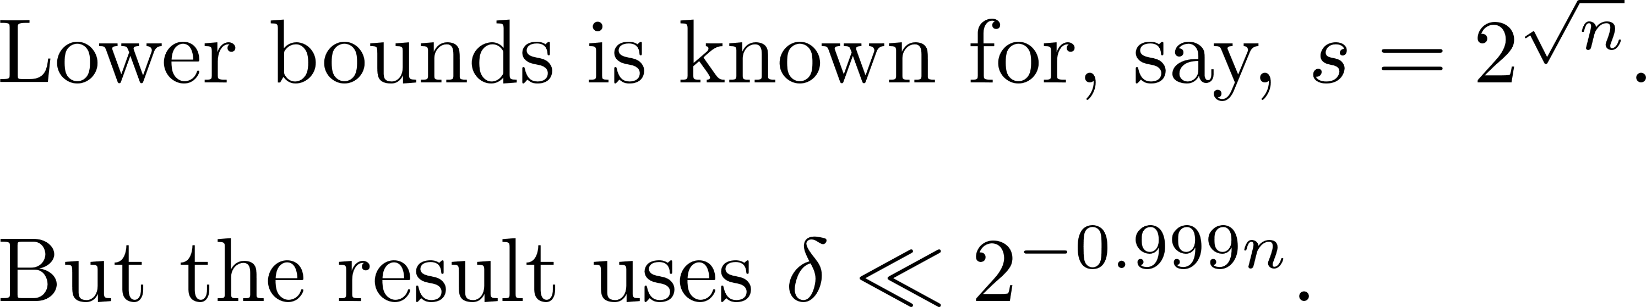
Magnification and LBs
Hard instances close to the border

Slide 21
3-SAT: NEXP vs. BPP
NEXP: non-deterministic exponential time.
BPP: randomized polynomial time.
Widely believed that NP is not contained in BPP.
But consistent with current knowledge that even NEXP might be contained in BPP.
We would like to connect the derandomization frontier to proving super-linear lower bounds for 3-SAT.

Slide 22
NEXP vs. BPP
The ideal connection
Weak lower bound for NP
Derandomization frontier for BPP
3-SAT vs. BPTIME[m^{1.001}]
“Thm”. If 3-SAT is not in BPTIME[m^{1.001}] then NEXP is not contained in BPP.
We don’t know how to prove this result…
But we can establish a connection using the notion of refuter.

Slide 23
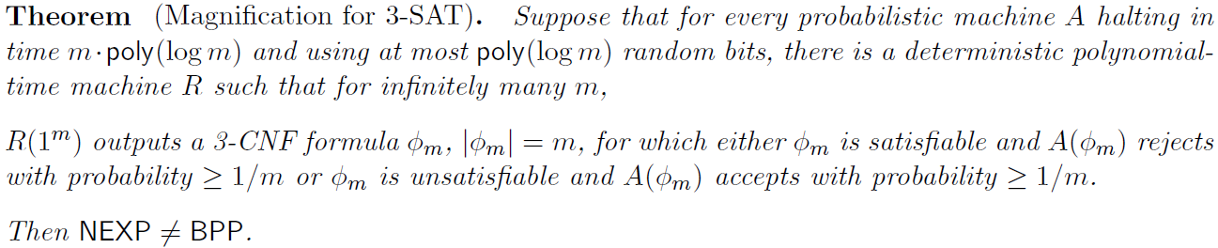
Known: Deterministic refuter for deterministic SAT algorithm (Gutfreund-Shaltiel-Ta-Shma, 2007)
Known: Randomised refuter for randomised SAT algorithm (Gutfreund-Shaltiel-Ta-Shma, 2007)
Deterministic refuter for randomized almost linear-time algorithm using poly(log m) random bits.

Slide 24
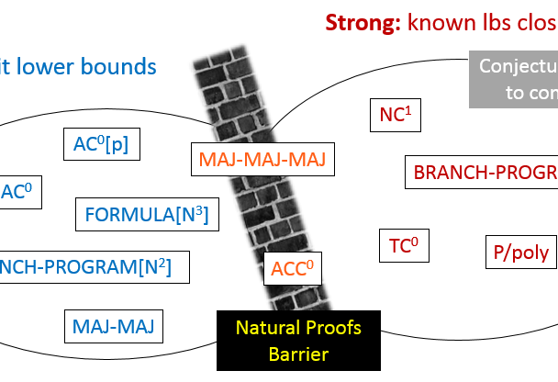
Interpretation
Gap between weak and strong circuit classes is somewhat illusory,
or at the very least
depends on the problem for
which we try to prove
lower bounds.
In theory, sufficient to study weak circuit classes.

Slide 25
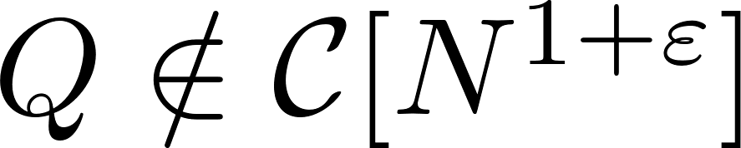
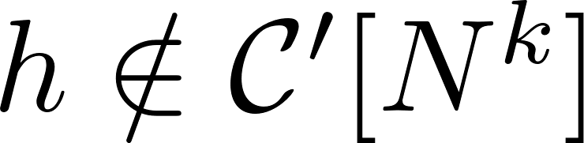
Comments about the proofs
Typical Result:
Each proof follows the natural approach:
Use that h is in polynomial size to argue that Q is in almost-linear size.
For this idea to make sense, instances of h employed in the proof need to be of sub-polynomial size.
But the technical details are substantially different in each case.

Slide 26
k-vertex-cover: NP vs. NC¹ from “super-linear” AC⁰ lower bounds.
- Kernelization algorithm from Parameterized Complexity Theory.
- Use known results about power of AC⁰ to implement it in almost-linear size.
- Use NP in NC¹ and collapse of NC¹ to sub-exp AC⁰ to solve compressed instance.
Average-case MCSP:
NP vs. NC¹ from “super-linear” formula lower bounds.
- Random projection / Occam’s Razor (an idea from Learning Theory).
- Reduction to certain succinct version of MCSP (worst-case formulation).
- Use NP in NC¹ to solve compressed instance. Standard Derandomization.
3-SAT
NEXP vs. BPP from det. refuters for rand. almost-linear time algorithms.
- Highly efficient PCP Theorem.
- Easy witness method / [IKW01].
- Random projections to subtle succinct version of 3-SAT.
- Notions of time-bounded Kolmogorov Complexity.

Slide 27
Main open problems
Approach explores upper bounds and lower bounds simultaneously
1. New lower bounds via hardness magnification?
2. Barriers to Magnification?
Hardness magnification seems to avoid natural proofs.
Is there a reason why this approach might not lead to super-polynomial lower bounds?
3. “Generic” Hardness Magnification in Boolean Complexity?

Slide 28
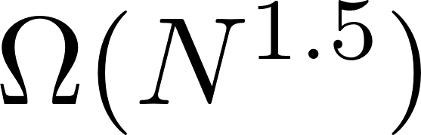
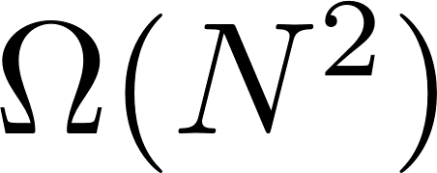
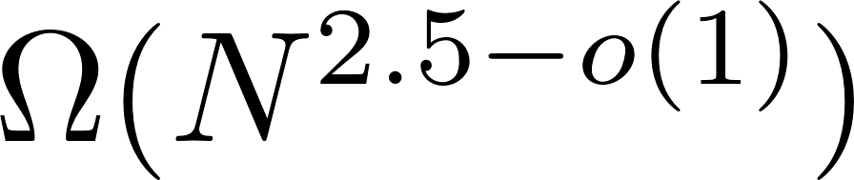
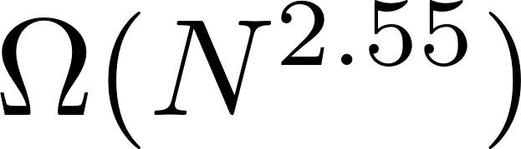
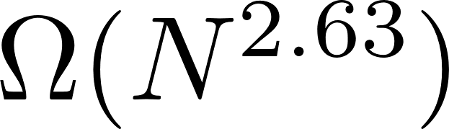
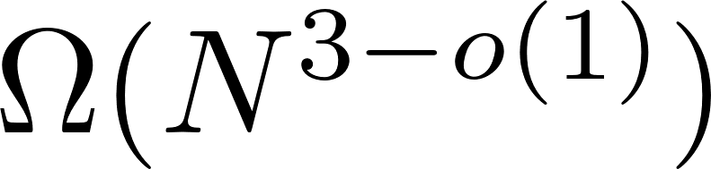
Oliveira-Pich-Santhanam (2018)
Previous results: hardness magnification around linear size bounds.
Subbotovskaya 1961
Khrapchenko 1971
Can we use emerging theory to shed light on current lower bound frontiers
(such as cubic formula lower bounds)
Andreev 1987
Nisan and Impagliazzo 1993
?
Paterson and Zwick 1993
Hastad 1998
Formula Size Lower Bounds

Slide 29
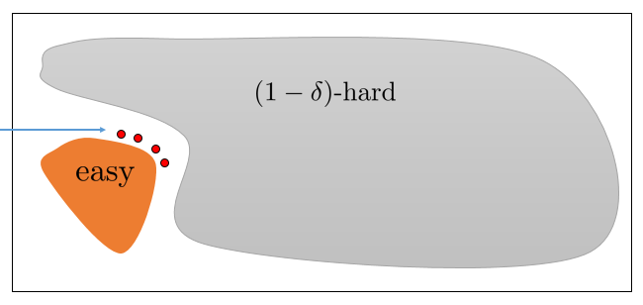
Previously: Average-Case MCSP
New Results: worst-case meta-computational problems.
Techniques that remove the gap between YES and NO instances, making lower bound proofs easier.
New problem Q refers to time-bounded Kolmogorov complexity instead of circuit complexity of strings.
Magnification thresholds tend to appear slightly above current lower bound frontiers.
Example: Magnification for Q at Formula[N^{3.001}] (implying EXP not in NC¹)
(Unconditionally, we can show Q not in Formula[N^{1.999}].)

Slide 30
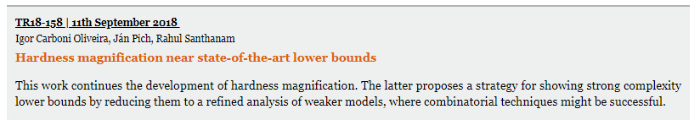
Oliveira-Pich-Santhanam (2018)
- First hardness magnification result for standard worst-case version of MCSP.
- Not known to be kernelizable/compressible.
“A layer of parities away from EXP not in NC^{1”}
- New techniques/proof template are necessary.
Also: new approach to separate EXP from NC¹.

Slide 31
Thank you

Slide 32
Appendix A: Other forms of magnification

Slide 33

Other forms of magnification: worst-case vs. average-case lower bounds
Worst-case lower bound from [HS17]:
MCSP[s] is a highly unbalanced Boolean function.
But solving MCSP[s] on average admits a natural definition:
We show:
Theorem. If worst-case lower bound can be extended to the average-case,
then NP requires formulas of quasi-polynomial size.

Slide 34
Appendix B: Sketch of some proofs

Slide 35
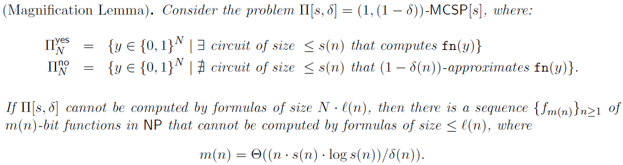
Magnification of formula lbs

Slide 36
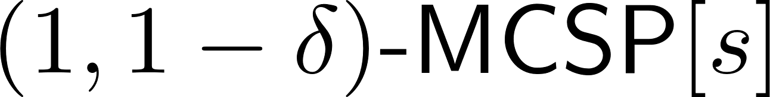
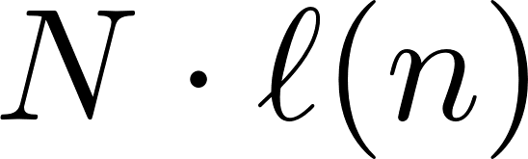
Proof by contrapositive. We use randomized formulas and reduce to:
Problem is in NP
Succinct-MCSP: Sequence of t pairs (x,b), x in {0,1}^{n}, b in {0,1}.
Is there a circuit of size at most s consistent with these pairs?
Original input length: N, but Succinct-MCSP instance is of length m(n) << N.
Intuition: If Succinct-MCSP has formulas of size N^{o(1)}, then we can show that
has randomized formulas of size N^{1 + o(1)}.
A careful derandomization gives deterministic formulas of size

Slide 37
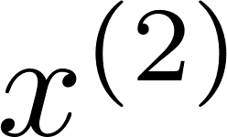
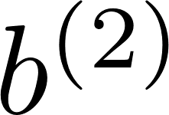
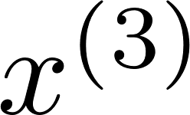
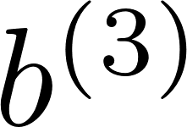
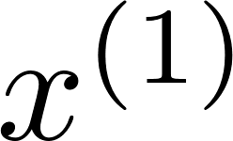
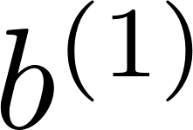
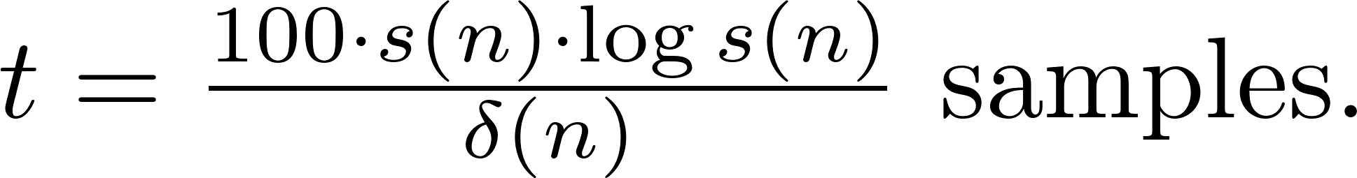
The random projection: a standard argument motivated by learning
Instance of Succinct-MCSP
…

Slide 38
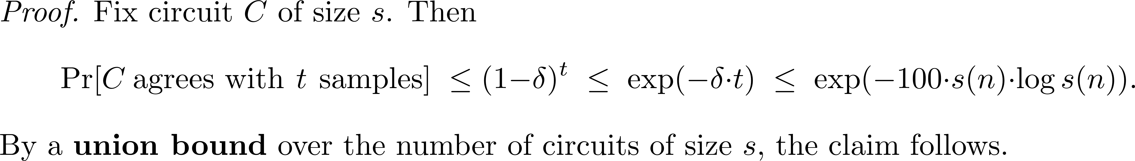

Slide 39

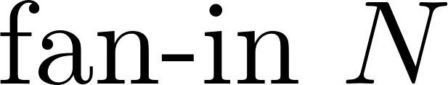
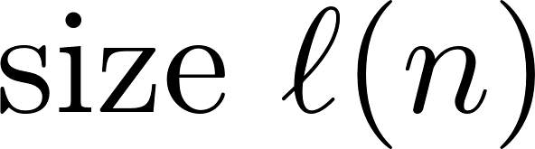
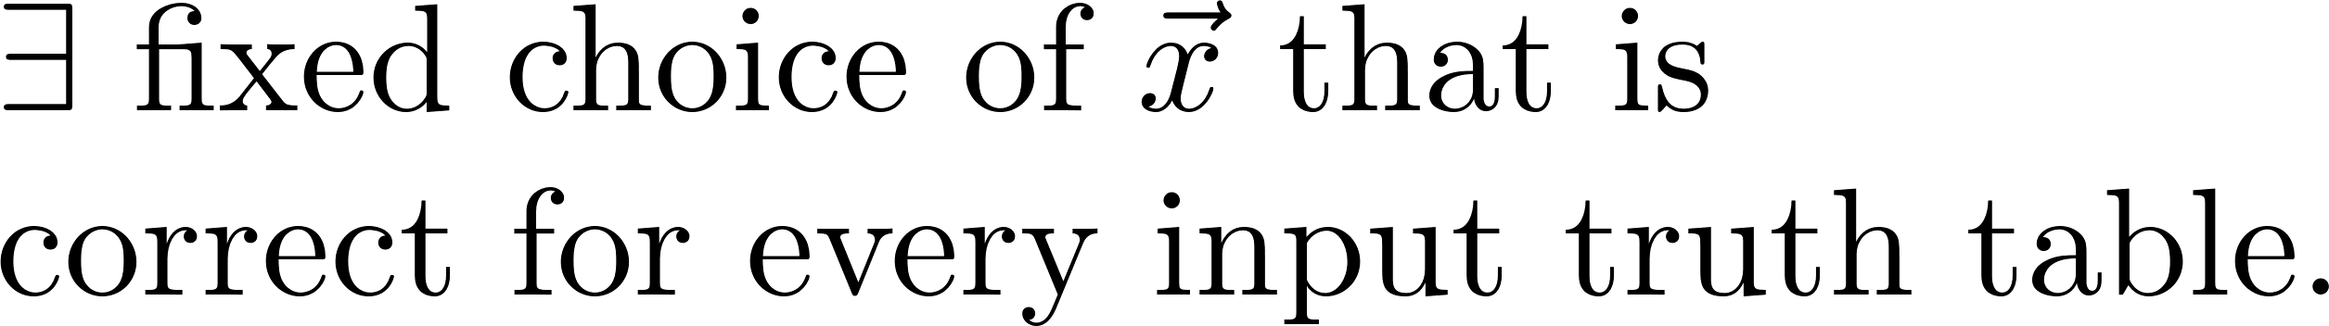
Derandomization and
final formula size
Instance of
Succinct-MCSP
truth table | randomness

Slide 40
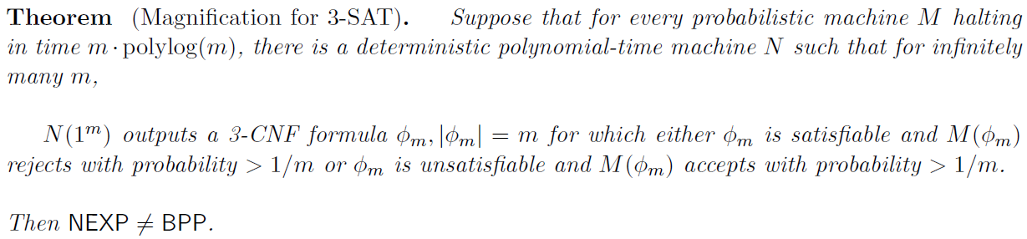
Magnification of 3-SAT lbs
New ingredients required in the argument:
- Highly efficient version of the PCP Theorem
Easy witness method / IKW (succinct witnesses)
Notions of Kolmogorov complexity

Slide 41
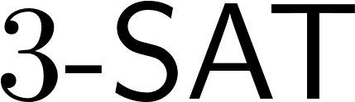
Proof is also by contrapositive. Assume NEXP is contained in BPP.
Let’s try to design an almost-linear time randomized algorithm for 3-SAT.
Analogous approach:
- We try to reduce, very efficiently,
to a certain sketched version of
3-SAT.
- Then use NEXP contained in BPP to design almost-linear time algorithm.
entries of truth table
input clauses
circuits
assignments
circuit computes input truth table
satisfying assignment

Slide 42
entries of truth table
input clauses
circuits
assignments
GAP for 3-SAT is created by an application of a very efficient version of the PCP Theorem:
[BGH+06, Din07, BS08].
circuit computes input truth table
satisfying assignment
Random Projection
Explore GAP
between YES and NO
instances
?

Slide 43
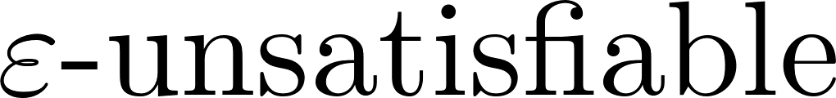
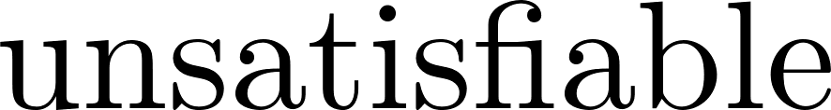
Now we randomly project m input clauses to poly(log m) clauses.
This produces a certain “random sketch” of the input instance.
Ideally:
projection
projection
?
Issue: Each fixed assignment is killed w.h.p. but we cannot union bound over all possible assignments.

Slide 44
There we only cared about circuits of size at most s(n) << N (initial input length).
3-SAT:
Here we care about all possible assignments, not just about those of “low complexity”.
Idea: Use notion of Refuter + notion of complexity of assignment.
Variant of time-bounded Kolmogorov Complexity

Slide 45
Remarks
Proof is a careful randomized reduction. Definition of “sketched” version of the 3-SAT problem is somewhat tricky.
Argument employs a case analysis depending on the counter-examples (formulas) generated by (candidate) Refuter:
Unsatisfiable,
Satisfiable by low complexity assignment,
Satisfiable, but only by high complexity assignments.
Case (c) uses the notion of “succinct witnesses” as in Impagliazzo-Kabanets-Wigderson (2001), and corresponding connection to NEXP vs. BPP problem.

