Slide 1

The Power of Negations in Cryptography
Igor C. Oliveira
Theory Lunch - Columbia
May 8th

Slide 2



Joint work with:
Alon Rosen
Tal Malkin
Siyao Guo

Slide 3
How simple can cryptography be?
  Cryptography in restricted/simple models:
  “Constant depth circuits” [AIK06]
  “Crypto with constant overhead” [IKOS08]
Philosophy behind this line of research:
  Positive results: extreme efficiency (crypto)
  Negative results: lower bounds (complexity theory)
“We all love monotone functions and monotone Boolean circuits.”
Rocco Servedio
What is “simple”?

Slide 4


Previous Work:
Monotone Cryptography? [GI12]
General circuits: {AND, OR, NOT}
OWFs, PRGs (assuming OWFs exist)
Monotone circuits: {AND, OR, NOT}
OWFs, PRGs (assuming OWFs exist)
“Monotone world”: a fundamental gap between OWFs and PRGs; “hardness-vs-pseudorandomness” paradigm fails!
[GI12] Can OWFs and PRGs be computed by monotone circuits?

Slide 5
[GI12] Can OWFs and PRGs be computable by monotone circuits?
How about other primitives and building blocks?
How about circuits with few negations?
(Power of negations in circuit complexity has been widely investigated:
[Tar88], [Hof92], [ST04], [BNT98], [Mor09], [Ros’15], …)

Slide 6
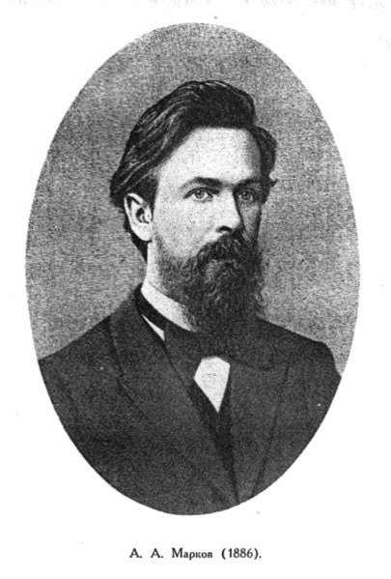
This Work:
Negation Complexity of Cryptography
Negation complexity of a function f: {0,1}^{n}  {0,1}^{m}
= Min number of NOT gates in any (multi-output) AND/OR/NOT circuit for f
Monotone Function: computed without negations.
[Markov58] Any function f can be computed with log n + 1 negations!

Slide 7
A single NOT gate
“NOT gate = fan-in two XOR gate”
“NOT gate = if-then-else = selection (over monotone circuits)”
Circuit C
Define C₀ and C₁
NOT
Apply selector
h: {0,1}³  {0,1}
C’

Slide 8
Our Results
# of negations
0
1
ω(1)
log n
(monotone function)
(any function [Mar58])
One Way Functions
✓ [GI12]
One Way Permutations
X
? (Open)
Small Bias Generators
X
? (Open)
✓
Pseudorandom Generators
X [GI12]
? (Open)
Weak Pseudorandom Functions
X [BBL98]
? (Open)
o(log n)
(tight up to O(1) mult term)
Hard-core bits
X
Extractors
X
log n – ω(1)
(tight up to O(1) add term)
Pseudorandom Functions
X
Error Correcting Codes
X
Cryptography except OWFs is
non-monotone
Many primitives are
highly non-monotone

Slide 9
[Goldreich-Izsak 12]
“Cryptography is non-monotone”
[This work]
Many Basic primitives require almost maximum number of negations among
all boolean functions.

Slide 10
Monotone and non-monotone Primitives

Slide 11
✓ Monotone OWFs [GI12]
[GI12] OWFs imply monotone OWFs:
- Middle slice of any OWF is a (monotone) weak OWF.
- (Hardness Amplification) Monotone weak OWF implies (monotone) strong OWF
Middle slice f’ of OWF f:{0,1}^{n}  {0,1}^{n} defined as
f’(x) = 1^{n} if |x| > n/2
f’(x) = f(x) if |x| = n/2
f’(x) = 0^{n} if |x| < n/2
(Efficiency: Berkowitz’s Theorem)
Can we show OWPs imply monotone OWPs?
- This transformation doesn’t preserve structure, i.e. not a permutation.

Slide 12
X Monotone OWPs
Thm1: If f: {0,1}^{n}  {0,1}^{n} is a monotone permutation, then
a permutation π: [n]  [n], s.t.
f(x₁, … , x_{n})= x_{π(1)} , … , x_{π(n).}
Efficient inverting algorithm to obtain y = f(x):
  Compute π’ = π⁻¹: for i in [n], if f(e_{i}) = e_{k} , then set π’(k)=i (e_{i} = 0^{i-1}10^{n-i})
  Given y₁,.., y_{n}, output y_{π’(1)}, …, y_{π’(n)}
Two Proofs for Theorem 1.
  Combinatorial proof : inductive argument.
  Analytic proof: easy to extend to regular OWPs.

Slide 13

Useful Tools
For monotone functions f, g: {0,1}^{n}  {0,1}
FKG’s inequality: (monotone functions are “positively” correlated)
Talagrand’s inequality: (the correlation can be lower bounded)
where
(C > 0 is a fixed constant)

Slide 14
Proof of Theorem 1
Thm1: If f: {0,1}^{n}  {0,1}^{n} is a monotone function and a permutation, then there is a permutation π: [n]  [n], s.t.
f(x₁, … , x_{n}) = x_{π(1)} , … , x_{π(n).}

Slide 15
Proof of Theorem 1
For any f_{j} and f_{k} by Talagrand’s inequality:
  f_{j}, f_{k} depend on disjoint input coordinates.
  f₁,...,f_{n} depend on disjoint coordinates.
    Each one depends on and equals to exactly 1 input coordinate.
  f is a permutation of input coordinates.
= 1/4
= 1/2
= 1/2
= 0

Slide 16
X Monotone PRGs and SBGs
[GI12] For monotone G: {0,1}^{n}  {0,1}^{n+1},
distinguisher D in monotone NC⁰, s.t.
| Pr[D(U_{n+1}) = 1] – Pr[D(G(U_{n}))=1] | > 1/n²
How about weaker notion of PRGs (for restricted distinguishers)?
  The distinguisher D above is non-linear.
  Monotone PRGs that fool linear distinguishers? (Known as SBGs)
Thm 2: For monotone G:{0,1}^{n}  {0,1}^{n+1}, there exists a linear function D s.t.
| Pr[D(U_{n+1}) = 1] – Pr[D(G(U_{n}))=1] | > 1/n²

Slide 17
Proof Idea of Theorem 2
Assume f₁ ,…, f_{n+1} are balanced. By KKL, each function has an influential variable. By pigeonhole principle, f_{j},f_{k} share the same influential variable i’.
By Talagrand’s inequality:
  A non-linear distinguisher [GI12]: output AND of f_{j} and f_{k}

Slide 18
The Linear Distinguisher
Recall:
Observe that FKG’s inequality holds for anti-monotone functions:
Combining the two inequalities:
  The linear distinguisher: output XOR of f_{j} and f_{k}

Slide 19
Many Primitives are highly non-monotone

Slide 20
Tool Box
FKG/Talagrand fails for non-monotone functions.
Structural results for function with negations:
  Markov ‘s theorem
  Decomposition theorem
  Selection tree

Slide 21
Tool #1: Markov’s Theorem
Chain X: (x¹, …, x^{k}) where x^{i} < x^{i+1} are strings in {0,1}^{n}
a(f, X): Alternating number of chain X with respect to f
= number of flips along the chain.
x¹ , … , x^{k}
f(x¹) , … , f(x^{k}) in {0,1}
[Mar58] Boolean function f computed with m negations:
MAX_{X} a(f, X) = O(2^{m}).

Slide 22
Pseudorandom Functions (PRFs)
Thm 3: If F {0,1}^{s} x {0,1}^{n}  {0,1} is (poly(n), 1/3)-secure PRF,
then F requires logn – O(1) negations.
Distinguisher: Fix arbitrary chain, e.g.
Y= (y⁰, y¹, …, y^{n}), where y^{i} = 1^{i}0^{n-i}
If a(f, Y) > n/4, outputs 1 otherwise 0.
Analysis:
Random function g: E[a(g,Y)] = n/2 a(f, Y) > n/4 w.h.p
F computed with m = log n – ω(1) negations: a(f, Y) < O(2^{m}) = o(n).

Slide 23




Tool #2: Decomposition
[BCOST’14] If f can be computable with t negations, then
f(x) = h(g₁(x), … , g_{T}(x)) , where :
i) Each g_{i} is monotone,
ii) T = O(2^{t}).
Upper bound on total influence I(f):
Large influence requires many negations.
Similarly, large
noise sensitivity
requires many negations.

Slide 24
Applications in Cryptography
Lower bounds for primitives:
  [GR00] Hardcore bits require large influence.
  [BG13] Extractors with appropriate parameters require large noise sensitivity.
  Consequence (check paper for more details):
  Extractors and hardcore bits require
  Ω(log n) negations.

Slide 25
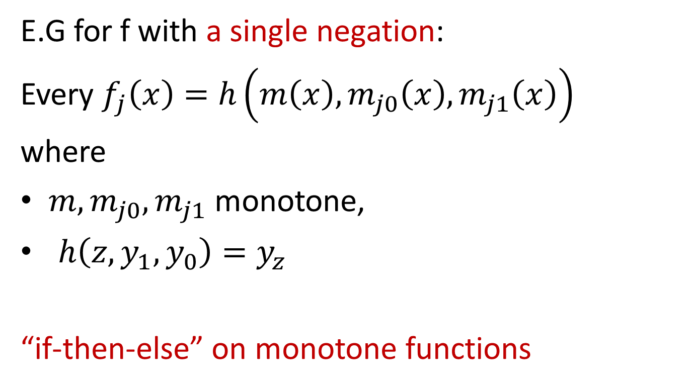
Tool #3: Selection Tree
E.G for f with a single negation:
Every $f_{j}\left(x\right)=h\left(m\left(x\right),m_{j0}\left(x\right), m_{j1}\left(x\right)\right)$
where
$m,m_{j0}, m_{j1}$ monotone,
$h\left(z,y_{1},y_{0}\right)=y_{z}$
“if-then-else” on monotone functions

Slide 26
Tool #3: Selection Tree
x in {0,1}^{n}
m
m(x)=0
m₀
m₁
m₀(x)=1
m₀₀
m₀₁
m₁₀
m₁₁
m₀₁(x)=1
m₀₀₀
m₀₀₁
m₀₁₀
m₀₁₀
…
…
…
m₁₁₁
f(x)=m₀₁₀(x)
Binary tree of depth t for f computed with t negations. Each node contains a monotone function.

Slide 27
Error-Correcting Codes (ECCs)
[BKS06] If E: {0,1}^{n}  {0,1}^{m} is a monotone ECC,
there are codewords with Hamming Distance at most m/n.
Thm 4. If E: {0,1}^{n}  {0,1}^{m} is an ECC computed with k negations,
there are codewords with Hamming Distance at most O(2^{k} m/n).
Consequence:
ECC with constant relative distance requires log n – O(1) negations
(optimal up to additive term).

Slide 28
Proof of [BKS06]
Consider a chain and its corresponding encoding:
E is monotone implies E(X) forms a monotone chain:
Hamming Distance between extremes at most m.
Some adjacent pair of codewords has distance at most m/n.

Slide 29
Lower bound for ECCs
Chain X = (x¹, …, x^{n})
m
m(x^{i+1})=…=m(x^{n})=1
m(x¹)=…=m(x^{i})=0
X₀ = (x¹, …, x^{i})
m₀
m₁
X₁= (x^{i+1}, …, x^{n})
X₀₁
m₀₀
m₀₁
m₁₀
m₁₁
X₀₁₀
m₀₀₀
m₀₀₁
m₀₁₀
m₀₁₀
…
…
…
m₁₁₁
|X₀₁₀| at least n/2^{t}
Binary tree of depth t for E with t negations
Each node contains a monotone function
E(X₀₁₀) = m₀₁₀(X₀₁₀) forms a monotone chain!

Slide 30
Summary
Cryptography is non-monotone except for OWFs:
  KKL, FKG, Talagrand’s inequality, …
  OWPs, SBGs, PRGs, (weak) PRFs
Many primitives are highly non-monotone
  Alternating chains - PRFs
  Bounds on Influence and Noise Sens. - HCBs, EXTs
  Selection tree - ECCs

Slide 31
Open Problems and Directions
Negation complexity of OWPs, PRGs.
  Is there a OWP/PRG computable with 1 negation?
Negation complexity of weak PRFs.
  Is there a weak PRF computable with 1 negation?
  (PRFs require log n – O(1) negations)
Negation complexity of reductions?

Slide 32

Thank you!

