Slide 1
Pseudodeterministic Constructions in Subexponential Time
Igor Carboni Oliveira
University of Oxford
(Joint work with Rahul Santhanam)
October 19th - Algorithms and Complexity Theory Seminar (Oxford)

Slide 2
Plan of the Talk
Part I.
- Motivation, background, description and discussion of our results.
(Mostly focused on prime numbers, but results are more general.)
Part II.
- Main ingredients and ideas used in the proof of main result.

Slide 3
Motivational Problem
Generating prime numbers:
  Input: N (in unary).
  Output: A fixed N-bit prime p_{N}.
Can we solve this problem deterministically in time poly(N)?

Slide 4
A Simple Algorithm
Enumerate N-bit integers in sequence, testing each one for primality using the AKS Algorithm.
Strong number-theoretic conjectures imply this algorithm halts in poly(N) time, but they seem beyond the power of current techniques.
Best provable guarantee on running time for this algorithm is
2^{0.525 N}, due to [BHP2001].

Slide 5
Attempts at Improvements
Best known algorithm is due to [LO87].
It proceeds via approximate computation of the zeta function, and has running time guarantee 2^{N/2+o(N)}.
The Polymath 4 Project (2009) attempted to improve the state of the art, but succeeded only in giving conditional improvements [TCH12].

Slide 6
A Relaxed Requirement
Fast deterministic algorithms seem to be hard to design and analyse, but perhaps randomness could help us?
Obvious randomized algorithm:
Generate N-bit integer X at random.
Test for primality, outputting X if the test succeeds.
(By the Prime Number Theorem, probability of success is Ω(1/N).)
Problem: This doesn’t generate a fixed prime! Output depends on the randomness of the algorithm.

Slide 7
It is not so clear how to obtain a fast deterministic algorithm.
On the other hand, randomized generation is easy, but does not produce a fixed prime number.
Is there an intermediate notion that could perhaps be useful?

Slide 8
Deterministic, Randomized
Fix a property Q, such as Primes.
Given N (in unary),
Find an element/string y_{N} in Q such that |y_{N}| = N.
1^{N}
1^{N}
Computation paths of the Algorithm
y_{N} = f(1^{N})
y¹
y²
y³
y¹
y⁴
⊥
⊥
…
Deterministic
(output in Q)
Randomized
(w.h.p., output in Q)

Slide 9
Pseudodeterministic
Pseudodeterministic Algorithm:
A canonical solution is output with high probability.
1^{N}
1^{N}
1^{N}
y²
⊥
f(1^{N})
…
y_{N} = f(1^{N})
f(1^{N})
⊥
f(1^{N})
f(1^{N})
y¹
y²
y³
y¹
y⁴
⊥
⊥
…
Deterministic
(output in Q)
Pseudodeterministic
(w.h.p., fixed output in Q)
Randomized
(w.h.p., output in Q)

Slide 10
Pseudodeterministic Algorithms
By standard amplification, we can assume the canonical solution is output with probability at least 1 – exp(-N).
Viewed as a black-box, the output of the algorithm is deterministic to any computationally bounded observer.
Pseudodeterminism comes in two flavours:
Bounded-error and Zero-error Algorithms.

Slide 11
Bounded-error vs. Zero-error
1^{N}
1^{N}
y²
⊥
f(1^{N})
…
f(1^{N})
f(1^{N})
⊥
f(1^{N})
⊥
f(1^{N})
f(1^{N})
…
f(1^{N})
⊥
f(1^{N})
f(1^{N})
Bounded-error
(w.h.p., fixed output in Q)
Zero-error
(w.h.p., fixed output in Q)
Fixed output f(1^{N}) w.h.p.,
but there could be other
outputs in Q.
Fixed output f(1^{N}) w.h.p.,
and this is the only non-⊥ output

Slide 12
Zero-error Algorithm is executed on different machines
and/or using different sources of randomness:
The same N-bit prime number is generated.

Slide 13
Literature on pseudodeterminism
Pseudodeterminism was first defined and studied in:
Eran Gat and Shafi Goldwasser [GG11]:
“Probabilistic search algorithms with unique answers and their cryptographic applications”.
Further investigated in [GGR13], [GG15], [Gro15], [GGH17], [Hol17], [OS17].
Some of these works developed algorithms for specific problems such as finding a bipartite matching (in parallel), a non-zero of a polynomial, etc.

Slide 14
Questions
Gat-Goldwasser (2011):
Is there an efficient pseudodeterministic algorithm
for generating prime numbers?
More generally,
Is it the case that the generation problem
for every easy and dense property Q can be solved pseudodeterministically in polynomial time?

Slide 15
Main Results
Theorem 1. There is a zero-error pseudodeterministic construction
of primes running in sub-exponential time 2^{No(1)} that succeeds for
infinitely many values of N.
Remark. On the input lengths where the algorithm fails, it always outputs the error symbol “⊥”.
Input length:
N-2 N-1 N N+1 N+2 N+3 …
Algorithm outputs w.h.p:
⊥ ⊥ p_{N} ⊥ p_{N+2} ⊥

Slide 16
Caveats in Theorem 1
Constructions are sub-exponential time rather than polynomial time.
Algorithm is not guaranteed to work for all input lengths N.
Non-constructivity: We know that an algorithm exists with the parameters given by Theorem 1, but we don’t know what it is!

Slide 17
Strength of Theorem 1. Particular case of a much more general result:
Definition. We say that a property Q contained in {0,1}* is γ(n)-dense if
|Q ∩ {0,1}^{n}| > γ(n)2^{n} for all large enough n.
Theorem 2. For every constant c > 0, at least one of the following holds:
(1) ∃ deterministic 2^{no(1)} time construction of a “hitting set” family {H_{n}} with
H_{n} ⊂ {0,1}^{n} s.t. ∀ (1/n^{c})-dense property Q in DTIME[n^{c}] and for infinitely
many values of n, Q ∩ H_{n} is non-empty.
(II) ∃ zero-error pseudodet. poly-time construction of a family {H’_{n}} s.t.
∀ (1/n^{c})-dense property Q in DTIME[n^{c}] and for every large enough n, Q ∩ H’_{n}
is non-empty.

Slide 18
“SPARSE” vs. “PSEUDO”
Theorem 2 unconditionally establishes that we live in (at least) one of the following computational worlds:
SPARSE. The generation problem for easy and dense properties can be solved deterministically in sub-exponential time by an algorithm that succeeds infinitely often.
PSEUDO. Any generation problem of this form can be solved pseudo-deterministically in polynomial time and on every input length.
[ The non-constructivity in Theorem 1 (Primes) comes from
not knowing in which of the two worlds we live! ]

Slide 19
Example: f-incompressible strings
Let f : {0,1}* → {0,1}* be an arbitrary injective polynomial time function.
Informally, f can be viewed as a “compression scheme”.
Def. We say that an n-bit string w is f-incompressible if |f(w)| > (1- ε)n.
Problem. Given 1^{n}, output a canonical f-incompressible string w of length n.
det. sub-exponential time, infinitely often
zero-error polynomial time, everywhere
SPARSE
PSEUDO

Slide 20
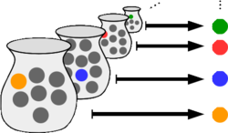
Analogy with the Axiom of Choice
A collection X of non-empty sets admits a choice function:
f : X → U X such that
f(A) is in A, for each set A in X.
(Picture from Wikipedia)
Roughly speaking, Theorem 2 can be seen as a
weaker analogue of the Axiom of Choice in Complexity Theory:
It provides canonical choices for properties Q = {Q_{n}} that are both easy and dense.

Slide 21
Explicitness and bounded gaps
Theorem 3: For each ε > 0, there is k > 0 such that there is an explicit
bounded-error pseudodeterministic construction of primes running in time
O(2^{Nε}) that succeeds for at least one N in any poly-sized interval [M, M^{k}] of
input lengths.
Partially addresses non-constructivity and infinitely often guarantee.
However, algorithm is no longer zero-error.

Slide 22
End of Part I.
Next: Sketch of the proof of the Main Result.
(in the context of generating primes)
Questions?

Slide 23
Theorem 1. There is a zero-error pseudodeterministic construction
of primes running in sub-exponential time 2^{No(1)} that succeeds for
infinitely many values of N.
Proof explores theory of pseudorandomness developed in a sequence of works over the last 30+ years.
A major difficulty is that the main results in this area are conditional.
(if some explicit function is sufficiently hard, then …)
However, Theorem 1 is an unconditional result!
A^{easy}
We use a win-win-win analysis:
A^{hard}
(3 variations of the hardness vs. randomness paradigm)
A^{super}

Slide 24
Pseudorandom Generators (PRG)
Definition. Fix a class C of boolean functions f:{0,1}^{n} to {0,1}.
A function G: {0,1}^{s} → {0,1}^{n} ε-fools C if for every function f in C:
| Pr[ f(z) = 1 ] - Pr[ f(x) = 1 ] | < ε.
In other words, for functions in C, the output of G is essentially indistinguishable from a truly random input.
We say that s is the seed length of G.
G is said to be quick/efficient if it can be computed in time poly(n, 2^{s}).
z = G(y)
x
s random bits
n random bits
24

Slide 25
A trivial example
Let C be the class {0, 1, x₁, …, x_{n}, NOT x₁, …, NOT x_{n}} viewed as
functions from {0,1}^{n} to {0,1} (i.e., “depth-0 circuits”).
Then G: {0,1}¹ → {0,1}^{n} given by G(0) = 0^{n} and G(1) = 1^{n}
completely fools C.
But G does not fool the function x₁ xor x₂.
25

Slide 26
Finding primes using a PRG
Proposition. Assume Primes is computable in a class C = {C_{n}} of functions,
and that {G_{n}} is a quick PRG that (1/n²)-fools functions in C_{n}, where each
G_{n}: {0,1}^{s(n)} → {0,1}^{n}.
Then we can deterministically generate an n-bit prime in time poly(n, 2^{s}).
Ideally, we would like to have seed length s = O(log n).
For Theorem 1, s < n^{δ} for every δ > 0 is sufficient.
26

Slide 27
Finding primes using a PRG (cont.)
Idea:
{0,1}^{n}
Output G(U_{s}) approx. acceptance
probability to error < 1/n²:
Some string in G(U_{s})
must hit the set Primes_{n}.
G(U_{s})
seed length s
Primes_{n}
(Otherwise, difference between probabilities violates correctness. )
Density approx. 1/n (Prime Number Theorem)

Slide 28
Unconditional PRGs
PRGs with good parameters are known only for very restricted classes.
Example: Circuits of size M and depth d can be ε-fooled by a quick PRG
G: {0,1}^{s} → {0,1}^{n} of seed length s = (log (M/ε))^{d + 5} [TX12].
Primes provably requires depth-d circuits of exponential size [ASS01].
PRG constructions for polynomial size circuits of depth O(log n) are not known.
Primes is in P [AKS02], hence computable by (unrestricted) polynomial size circuits.
28

Slide 29
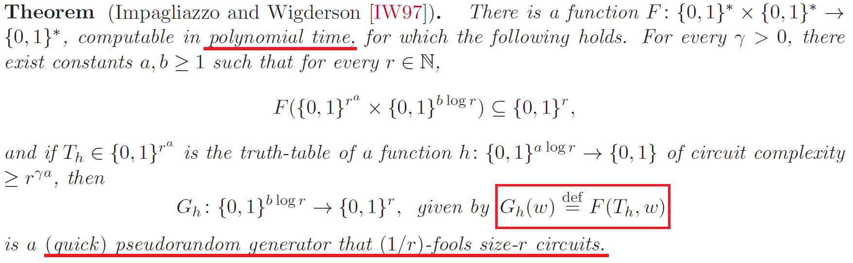
The Impagliazzo-Wigderson PRG
!
We currently don’t know how to efficiently generate the truth-table, which is equivalent to showing that E requires circuits of size 2^{ɣn}, for a fixed ɣ > 0.
29

Slide 30
The Easy Witness Method [Kab01]
Algorithm A^{easy}.
Input: 1^{N}
det. time
< exp(N^{2ɣ})
1. Generate all truth-tables T_{f} obtained from a boolean function
f: {0,1}^{log N} → {0,1} computable by Boolean circuits of size at most N^{ɣ}.
2. Let p_{N} be the first string T_{f} that encodes an N-bit prime number.
3. Output p_{N} if such a truth-table exists, otherwise output “fail”.
poly-time
[AKS02]
“A^{easy} searches for a prime that admits a succinct encoding.”
30

Slide 31
Analysis of A^{easy}
Lemma. If A^{easy} fails on every large enough input length, then
BPP is contained in ZPP.
Sketch. If A^{easy} fails on inputs of length n, then every n-bit prime encodes a truth-table of exponential circuit complexity when n is a power of 2.
A hard truth-table can be randomly guessed, checked, and used for derandomization in the [IW97] generator.
The simulation is zero-error: we only proceed when a prime number is found. By the Prime Number Theorem, we find one in expected polynomial time.
31

Slide 32
Why is a BPP collapse not enough?
Even BPP = P is hard to exploit in the context of generating primes.
This is a collapse between decision problems.
Prime generation is a search problem.
Standard search-to-decision reduction does not work.
Collapse from previous slide obtained using hard truth-tables and PRGs.
Still insufficient:
Distinct truth-tables give correct derandomization for decision problems.
But with different sets of pseudorandom strings:
No guarantee that the same prime number is generated.
!
32

Slide 33
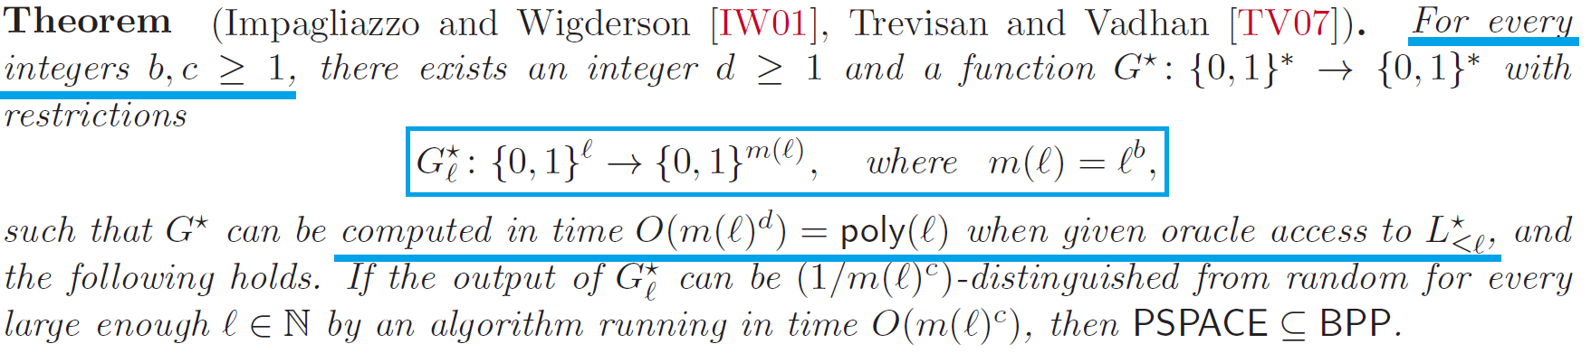
The Trevisan-Vadhan PRG [TV07]
This is a PRG that crucially exploits uniform computations.
It requires oracle access to a special PSPACE-complete language L*.
33

Slide 34
The Algorithm A^{hard}
Algorithm A^{hard}.
Input: 1^{N}
No need to have oracle access to L*,
and A^{hard} runs in det. time < exp(N^{100ε}).
1. Let L* be the PSPACE complete language used in the [TV07] PRG.
2. We instantiate [TV07] on L* over inputs of length N^{ε}, with a large enough polynomial stretch (N bits) and against algorithms running in time O(N²⁰).
3. Let L_{N} be the list of strings produced by the generator.
Output the first prime p_{N} in L_{N} if it exists, otherwise output “fail”.
Enough for AKS Algorithm
34

Slide 35
A useful complexity collapse
Lemma. If A^{hard} fails on every large enough input length, then PSPACE is
contained in BPP.
Proof. If A^{hard} fails on all large input lengths, the AKS Algorithm is a polynomial time distinguisher for the [TV07] PRG. By their main result, PSPACE = BPP.
Therefore, if both A^{hard} and A^{easy} fail on all large input lengths:
PSPACE = BPP = ZPP.
35

Slide 36
A^{super}: More hardness vs. randomness
We can assume that PSPACE is contained in ZPP.
Algorithm A^{super}.
Input: 1^{N}
1. Compute in polynomial space the lexicographic first truth-table T_{N} of size Nª that requires circuits of size N^{a/2}. This is a function over a log N input bits, for a large enough constant a.
2. We instantiate the [IW97] PRG using T_{N} to produce N pseudorandom bits that (1/N²⁰)-fools circuits of size N²⁰. The seed length is b log N, for some constant b.
3. Unconditionally, some prime p_{N} appears in the list of pseudorandom strings, and we output the first such prime.
36

Slide 37
Summary of the argument
A^{easy}: deterministic, sub-exponential time.
Lemma. If it does not succeed infinitely often, BPP = ZPP.
Main technique: Easy witness method [Kab01] and [IW97] PRG.
A^{hard}: deterministic, sub-exponential time.
Lemma. If it does not succeed infinitely often, PSPACE = BPP.
Main technique: PRGs for uniform polynomial time [TV07].
A^{super}: zero-error randomized, polynomial time.
Lemma. If A^{easy} and A^{hard} fail, A^{super} succeeds on every input length.
Main technique: Complexity collapses and [IW97] PRG.
37
37

Slide 38
Comments
Example of unconditional algorithm for a natural problem obtained from conditional derandomization results.
Essentially the same argument establishes Theorem 2
(unconditional hitting sets giving rise to the SPARSE and PSEUDO worlds).
To prove Theorem 3 (explicit algorithm with bounded gaps),
we need a more careful control over the previous arguments, and to
apply the hardness vs. randomness paradigm in a non-black-box way.
38

Slide 39
Comments (cont.)
Unfolding the constructions, final algorithm requires ideas from learning theory, error-correcting codes, IP = PSPACE (arithmetization), hardness vs. randomness, compression of truth-tables, etc.
As mentioned before, argument works for any easy and dense property.
Perhaps by tailoring these techniques to the problem of prime generation, one can obtain stronger results. (We have used only the Prime Number Theorem and the AKS Algorithm.)
39

Slide 40
Problems and Future Directions
Give a more natural construction for Primes.
Infinitely often deterministic generation of an n-bit prime in time 2^{o(n)}?
Improve our parameters (quasi-poly running time?, gaps between primes), and investigate limitations of our techniques.
Understand pseudodeterminism in other settings such as:
parallel computation, learning algorithms,
approximate counting problems.

