Slide 1

Unprovability of strong complexity lower bounds in bounded arithmetic
Igor Carboni Oliveira
University of Warwick
Dagstuhl Workshop
March/2023
1

Slide 2

Join work with Jiatu Li (Tsinghua)
2

Slide 3
Context
Goals of Complexity Theory include separating complexity classes and establishing circuit lower bounds
Unconditional results still weak and distant from main goals
e.g., hardness magnification sidesteps the natural proofs barrier using simple reductions
Barriers: relativization, natural proofs, algebrization, …
Useful, but tend to be formulated in an ad-hoc way and are limited in scope
3

Slide 4
Perhaps we simply haven’t been clever enough to design a better lower bound technique?
But there could be a deeper reason for the difficulty of establishing lower bounds
Intriguing possibility: complexity lower bounds might be unprovable
Motivates the development of a principled approach to understand the difficulty of analyzing computations
Standard framework to understand mathematical proofs and their limits: Mathematical Logic
4

Slide 5
Summary of Results (Informal)
We consider logical theories that can formalize advanced results from algorithms & complexity
Example: APC₁
Corollary of our Main Result
Proves the PCP Theorem
APC₁ cannot prove strong lower bounds separating the third level of the polynomial hierarchy
Proves AC⁰[Mod₂] lower bounds
Proves monotone lower bounds (approximation method)
…
See [Pich 2015] and [Müller-Pich 2020]
(∀∃∀ vs ∃∀∃ Computations)
Unconditional
We also introduce a convenient game-theoretic witnessing result that might be of independent interest
5

Slide 6
Plan
Bounded Arithmetic: Background and Previous Work
Results
Proof Techniques
Directions and Open Problems
6

Slide 7
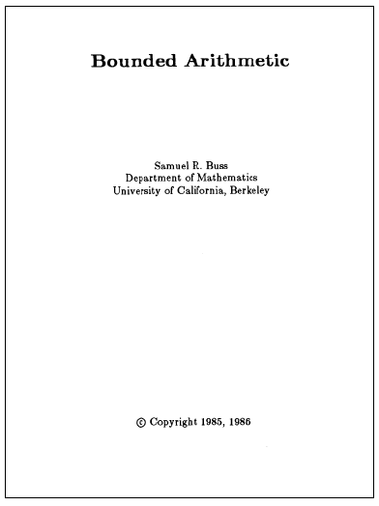
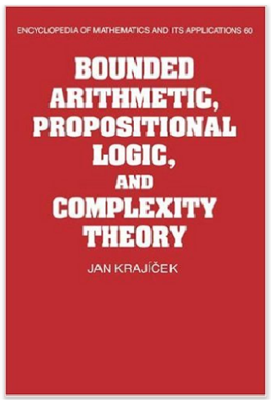

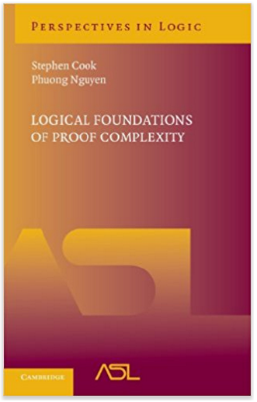
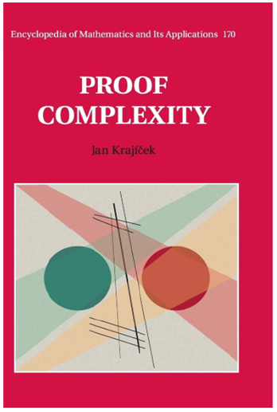

Bounded Arithmetic
Fragments of Peano Arithmetic capturing proofs that manipulate concepts from a given complexity class
A few notable examples:
- Cook’s theory PV₁ (1975), which formalizes poly-time reasoning
i
- Buss’s theories S (1986), corresponding to the levels of the polynomial hierarchy
2
- Jeřábek’s theory APC₁ (2007) for probabilistic poly-time reasoning
Intended Model:
Natural numbers
7

Slide 8

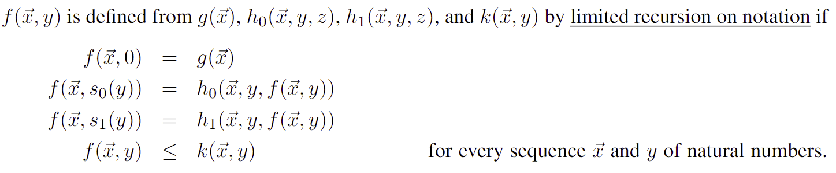
Polynomial Time Functions
Cobham (1965): FP is equivalent to the set of functions in
obtained from the base functions below by composition and limited recursion on notation.
8

Slide 9
Theories T
i
PV
quantifier free
9

Slide 10

The Strength of T
i
PV
10

Slide 11

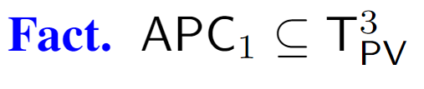
Theory APC₁
11

Slide 12
Relevant Previous Work
Razborov (1995) initiates the study of complexity lower bounds in bounded arithmetic.
…
Pich (2015), building on a technique from Krajíček (2011), establishes (conditional) unprovability results in sub-theories of T_{PV}
1
Müller and Pich (2020) highlight APC₁ as a suitable theory for the formalization of circuit lower bounds
Pich and Santhanam (2021) show the unprovability of strong complexity lower bounds in
T_{PV} and in a fragment of APC₁
1
12

Slide 13

Pich-Santhanam (Informal)
[PS’21] considers strong complexity lower bounds separating NP from coNSIZE:
Fix a poly-time nondeterministic TM M.
[PS’21] considers a sentence S_{M} stating that
For every input length n > n₀
Our main motivations:
For every co-nondeterministic circuit D of size 2^{nε}
M and D disagree on 1% of the inputs in {0,1}^{n}.
- Results for stronger theories?
- More natural formalization
(higher quantifier complexity)
1
They show that S_{M} is not provable in T_{PV} and in a certain fragment of APC₁
13

Slide 14
Plan
Bounded Arithmetic: Background and Previous Work
Results
Proof Techniques
Directions and Open Problems
14

Slide 15
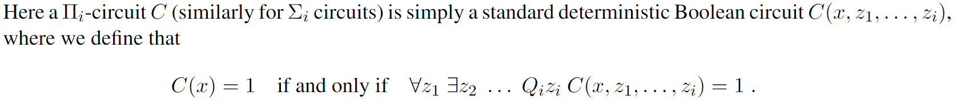

Formalization
proof can manipulate objects of bit length 2^{O(n)}
algorithms extracted from proof run in time 2^{O(n)}
15

Slide 16







Results
16

Slide 17
Plan
Bounded Arithmetic: Background and Previous Work
Results
Proof Techniques
Directions and Open Problems
17

Slide 18


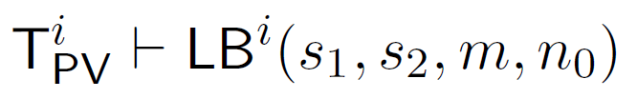
Proof Strategy
We extend the approach employed by [PS’21], which builds on [Pich’15] and [Krajíček’11]
Main challenges for us: stronger theory and quantifier complexity of
Suppose that
Key Idea: Proof of a complexity lower bound in BA yields a corresponding complexity upper bound
The lower bound and the upper bound contradict each other
18

Slide 19









Toy Example: Upper Bounds from Constructive Lower Bounds
19

Slide 20













Toy Example: Upper Bounds from Constructive Lower Bounds
20

Slide 21

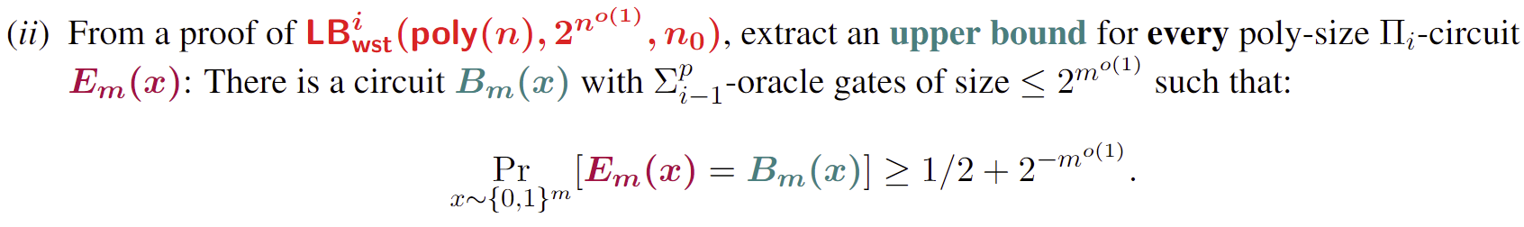
Main Lemmar
21

Slide 22
Main Lemmar
22

Slide 23

UT : A universal theory for T
i
i
PV
PV
23

Slide 24
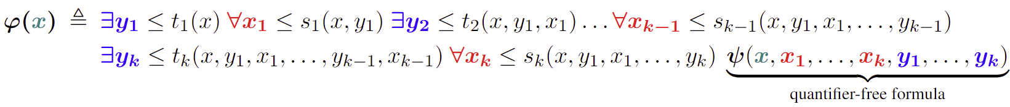
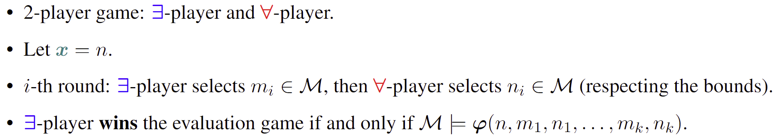
Game-Theoretic Witnessing Theorem
24

Slide 25
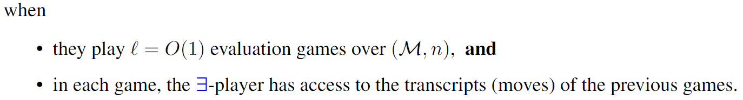
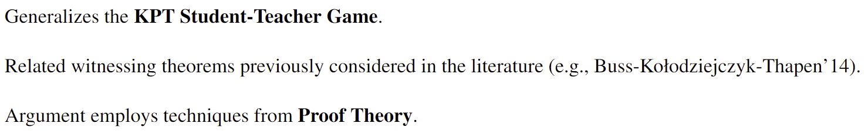
(Pudlak’92, Pudlak’06,
Buss-Kolodziejczyk-Thapen’14)
25

Slide 26













Toy Example versus Main Lemma
Techniques from Pseudorandomness
26

Slide 27
Plan
Bounded Arithmetic: Background and Previous Work
Results
Proof Techniques
Directions and Open Problems
27

Slide 28
Directions and Open Problems
1. Unprovability of lower bounds: evidence that corresponding upper bound is true?
2. Show that APC₁ cannot prove strong complexity lower bounds separating the second level of PH
3. Establish the unprovability of worst-case complexity lower bounds
4. Additional applications of the game-theoretic witnessing theorem?
Thank you!
28

Slide 29
References
29

Slide 30
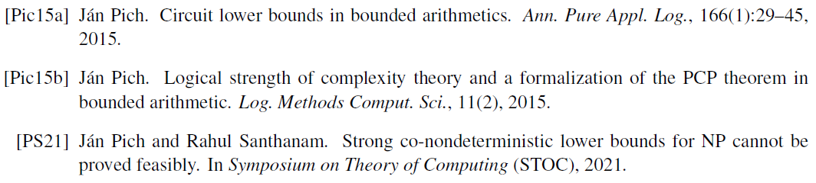
30

